Slide 1


CHARLES V. SCHAEFER, JR.
SCHOOL OF ENGINEERING AND SCIENCE
OVERVIEW
Jean Zu
Lore E. Feiler Dean
Fall 2025

Slide 2
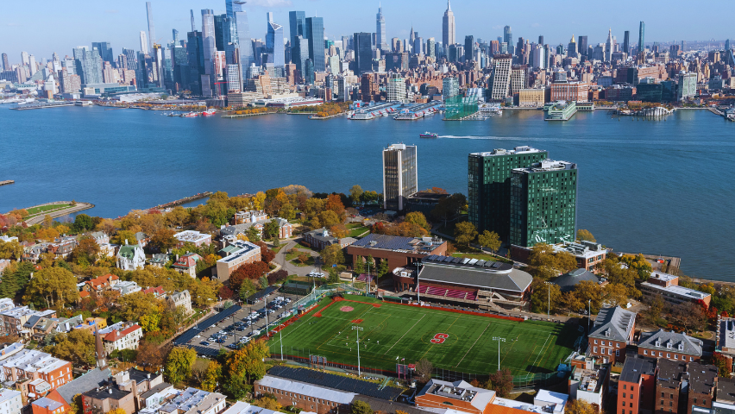
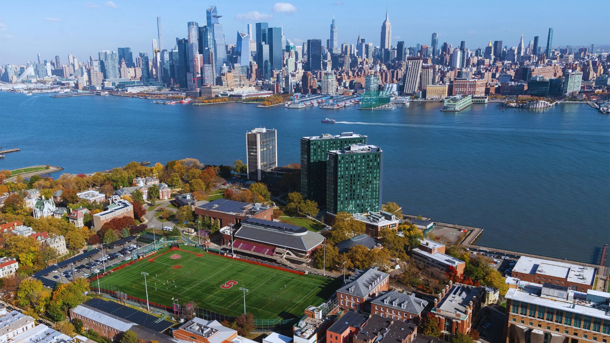
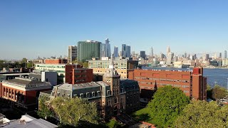

Slide 3
Stevens Institute of Technology
A premier, private research university with a mission to inspire, nurture and educate leaders in tomorrow’s technology-centric environment.

Slide 4
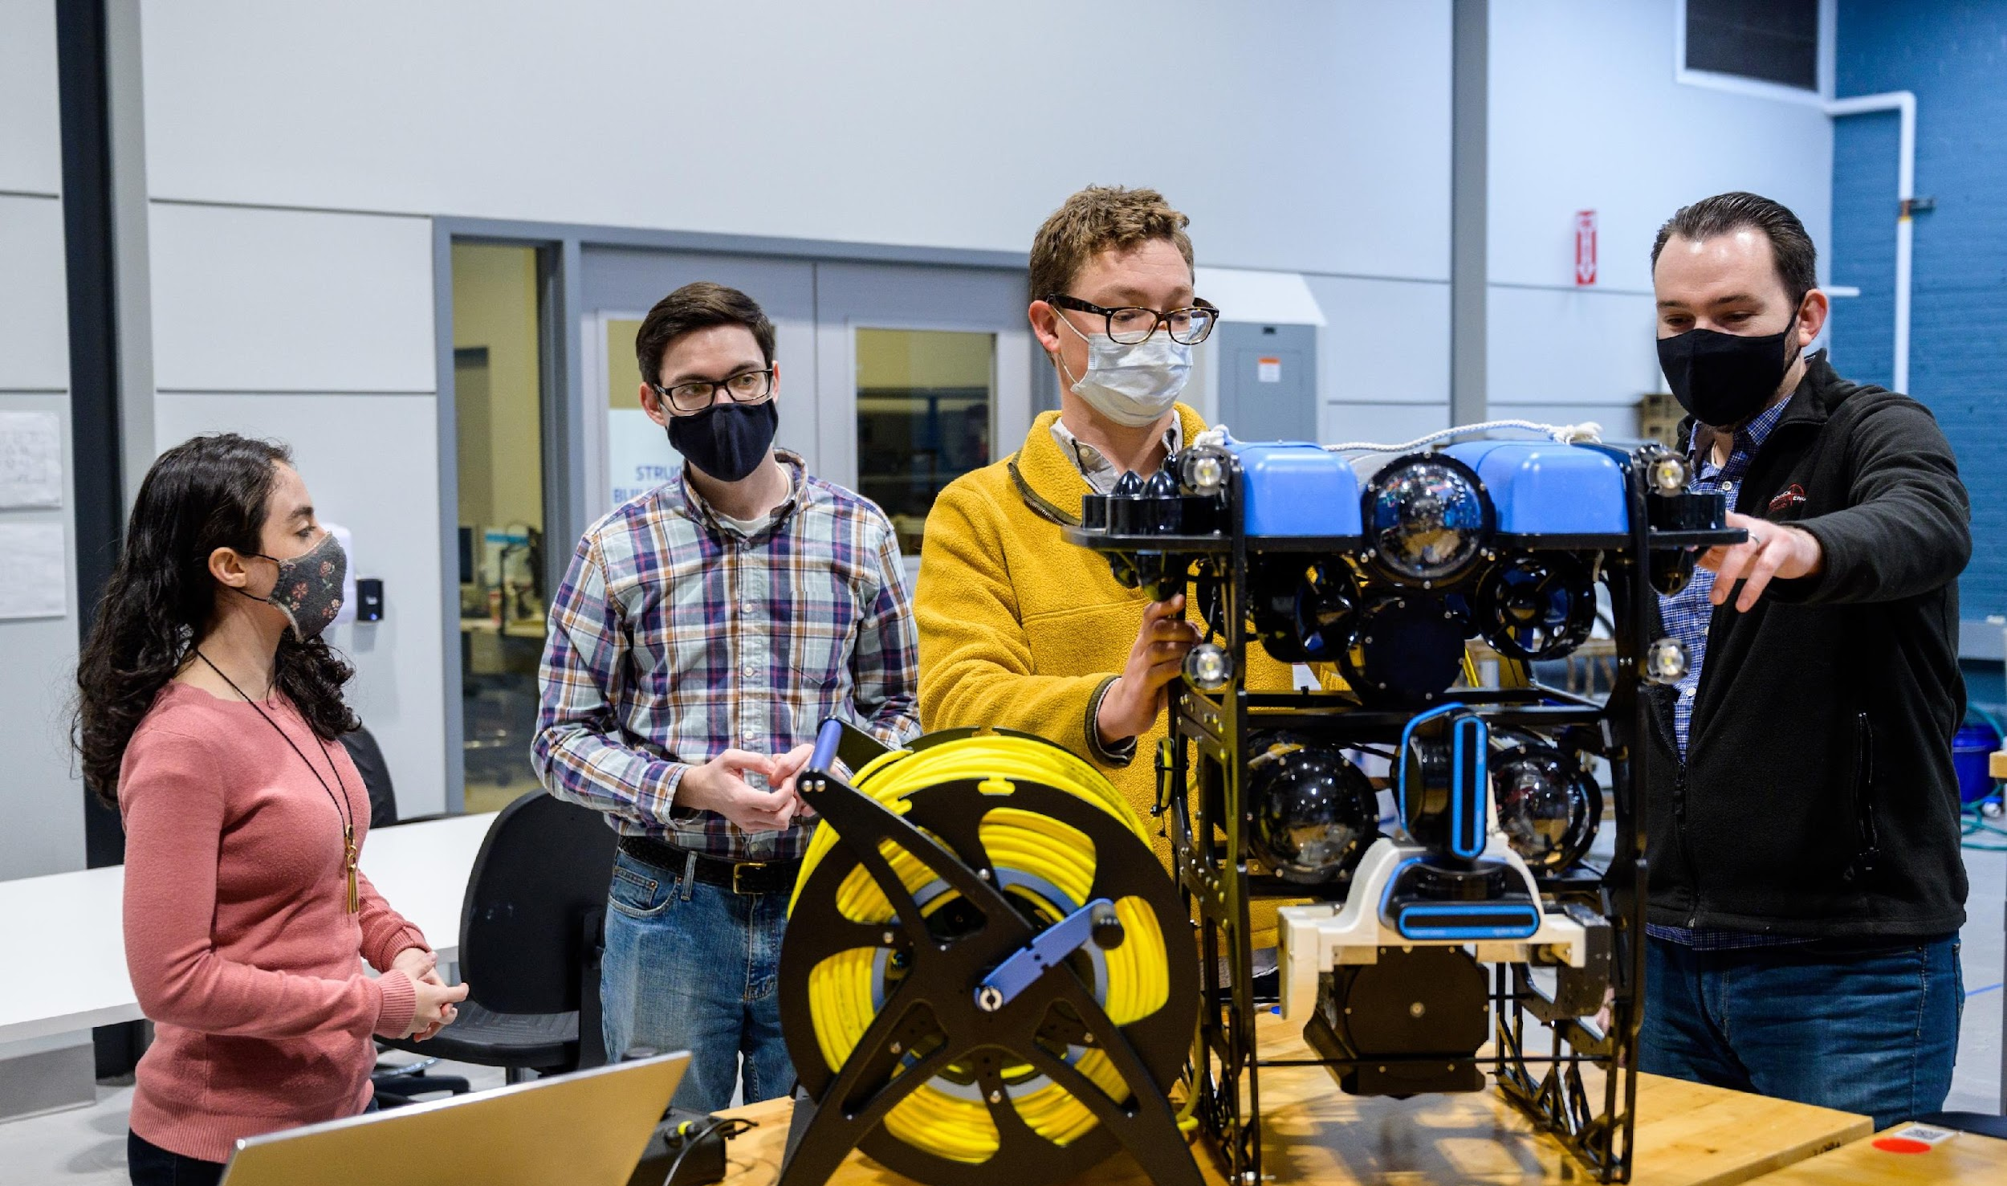
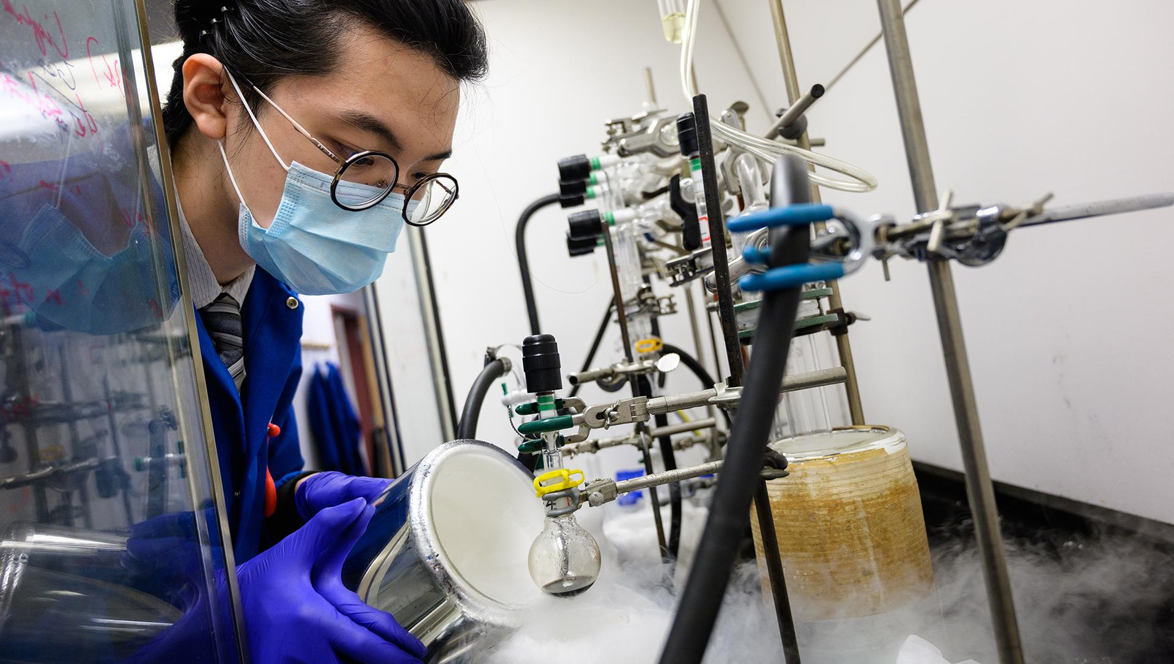
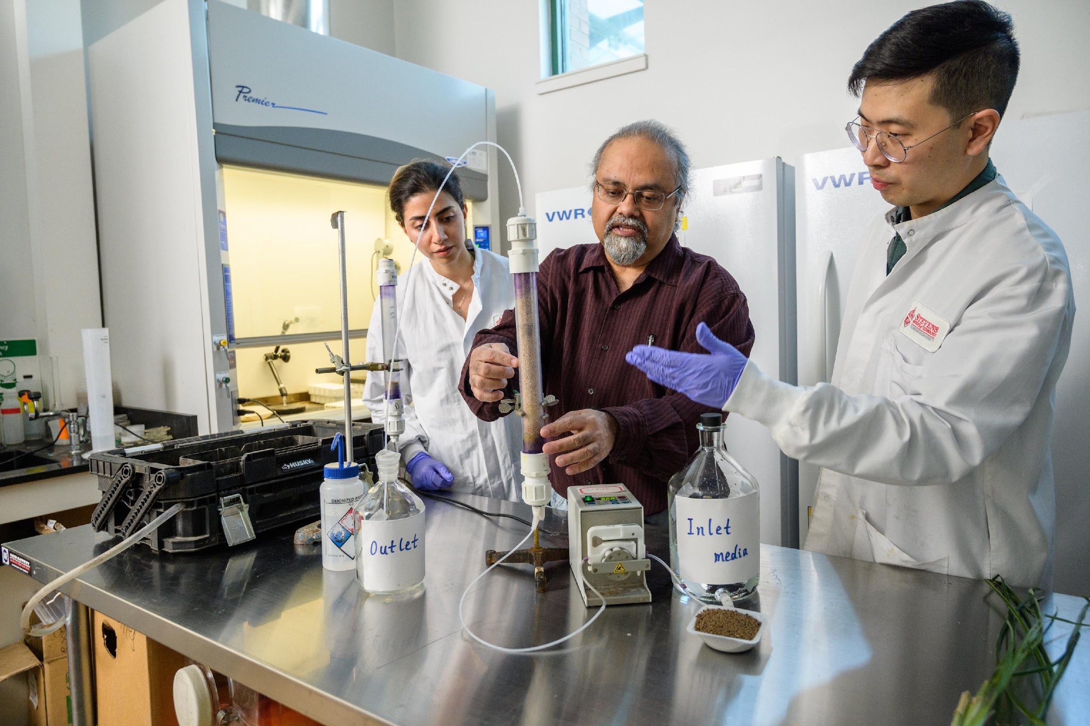
About Stevens
Established in 1870 by the Edwin A. Stevens family, America’s first family of inventors
Located in Hoboken, New Jersey, minutes from Manhattan
Introduced the first mechanical engineering degree in the U.S.
Technology is at the heart of everything we do
Prepares leaders for our technology-driven world
Advances science and technology research in areas of great societal need

Slide 5
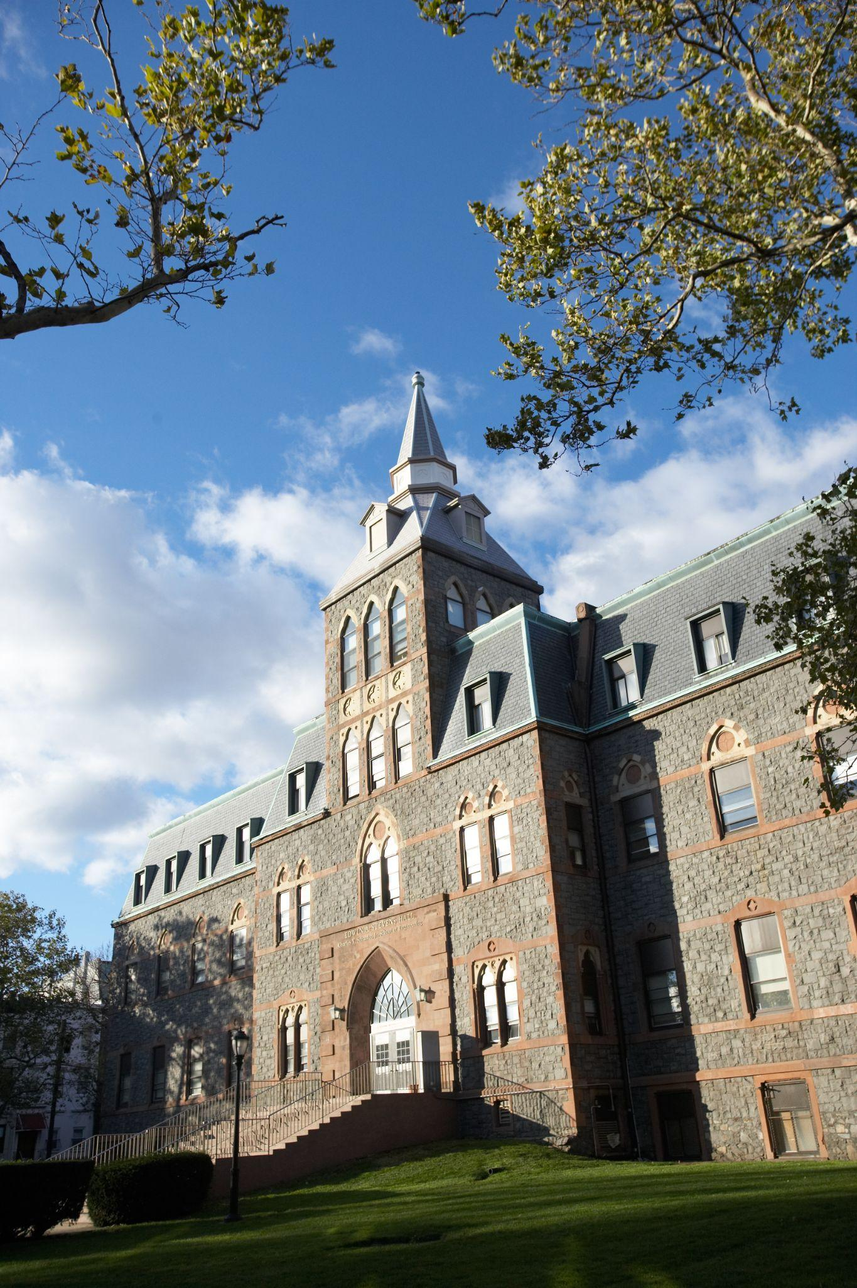
Legacy of Innovation
The Stevens Family: The First Family
of American Inventors
Established first college of Mechanical Engineering in the U.S.
Designed the steam ferry, T-rail and the first American-built steamboat locomotive
Built and operated the first United States commercial railroad
Instrumental in developing United States patent law
Created the America’s Cup racing series and designed and sailed the yacht America, the first winner of the Cup

Slide 6
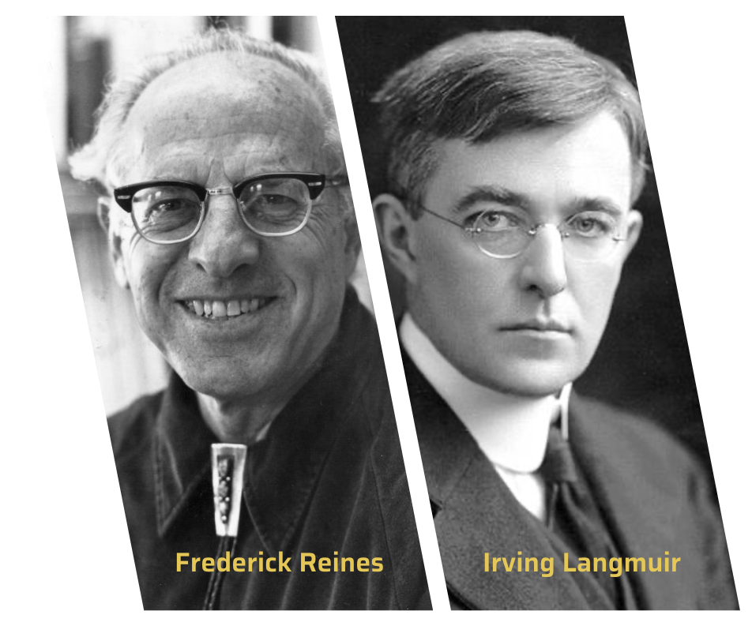
Nobel Prize Winners
Leaders in Chemistry and Physics
Frederick Reines ’39 M.S. ’41 Hon.D.Eng. ’84 - Recipient of the Nobel Prize in Physics in 1995 for the discovery of the neutrino
Irving Langmuir, Professor of Chemistry at Stevens Institute of Technology until 1909 - Recipient of the Nobel Prize in Chemistry in 1932 for his work in surface chemistry

Slide 7
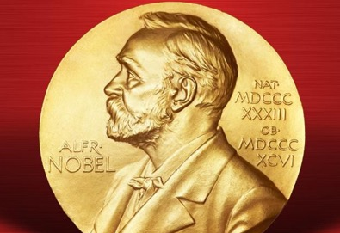
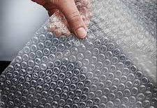

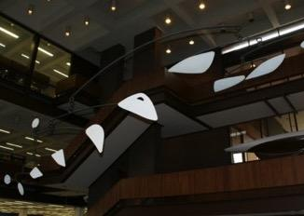
Pioneering Innovation
Stevens alumni have followed in the footsteps of the university’s founding family to become modern-day game-changers.
Created the field of scientific management
Invented the Gantt Chart
Co-founded GM and Texas Instruments
Created the art form known as the mobile
Directed command, service and lunar module design for NASA’s Apollo moon missions
Invented the IMAP email protocol
Invented bubble wrap

Slide 8
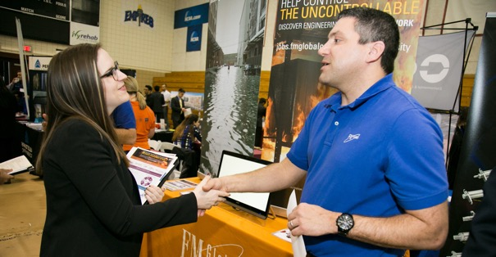
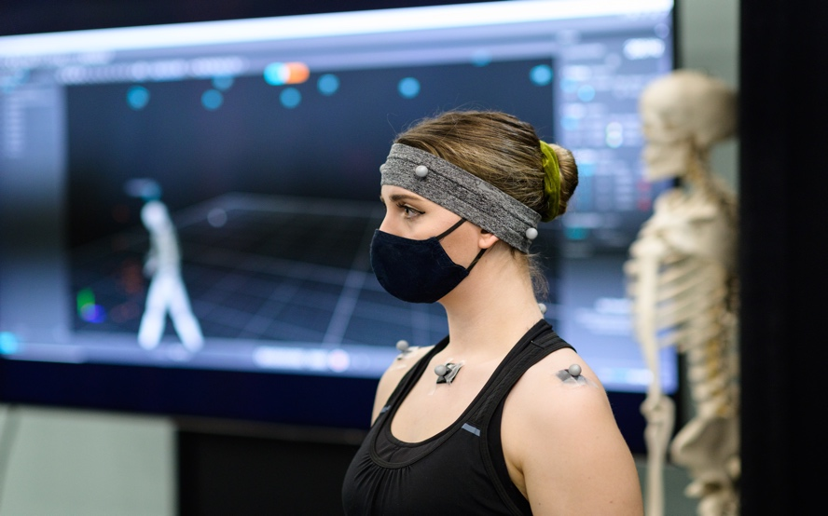
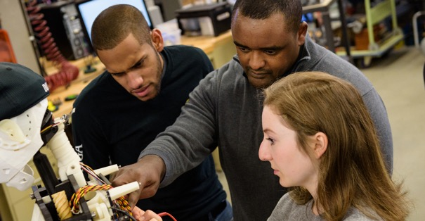
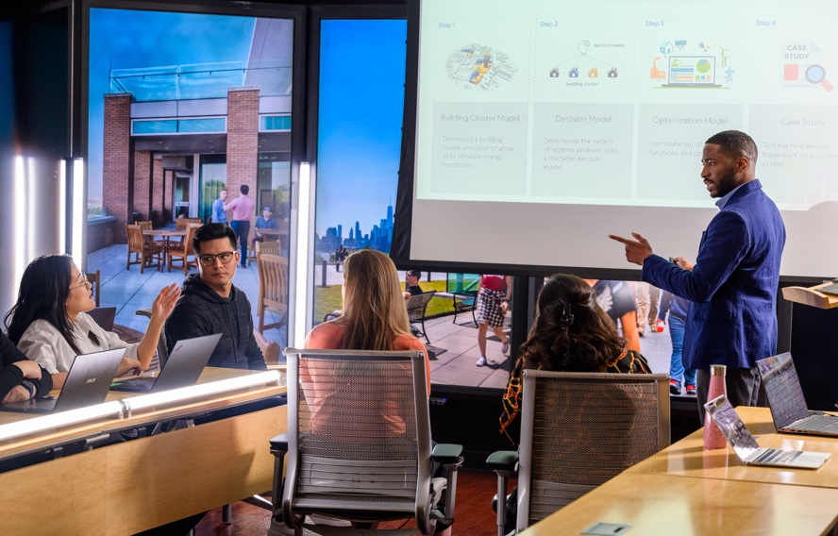
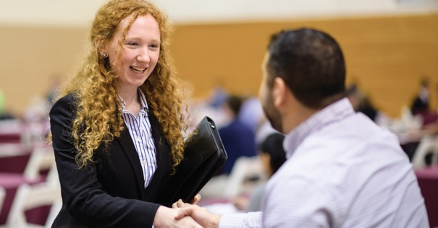
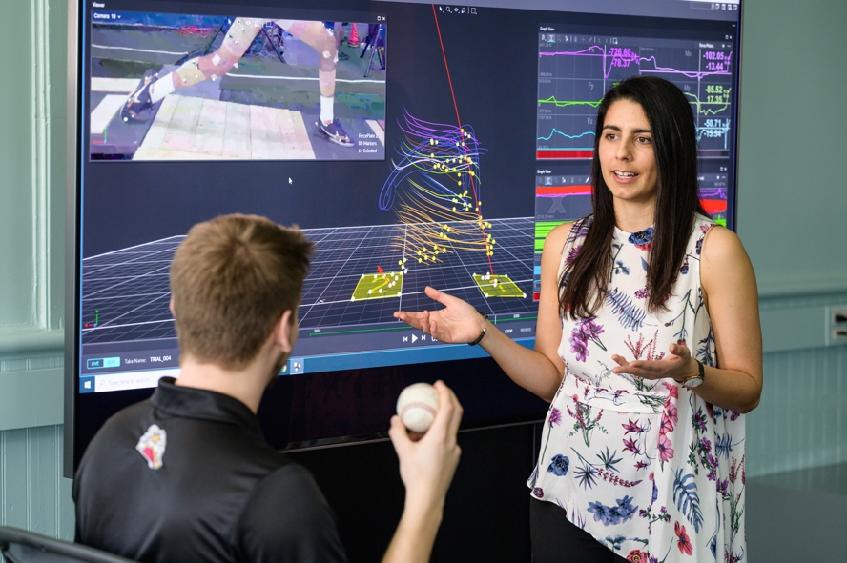
Driven by Real-World Experience
Cooperative education
Project-based learning
Faculty-mentored research
Case studies drawn from industry
Internships
Cross-disciplinary collaboration,
reflective of real-world projects

Slide 9







National Rankings and Recognition
#76
College Ranking
2024-25 U.S. News & World Report’s ranking of National Universities
#71
Undergraduate Engineering Program
2024-25 U.S. News & World Report’s ranking of National Universities
#56
Best Undergraduate Teaching
2024-25 U.S. News & World Report’s ranking of National Universities
#33
Most Innovative Colleges
2024-25 U.S. News & World Report’s ranking of National Universities
#19
Return on
Investment
2022 ranking among 4,500 colleges on ROI 40 years after enrolment
#36
College Ranking
2024 Wall Street Journal
College Pulse Ranking
#12
Career Placement
Best Value Colleges, 2024
Among
America’s Top Colleges
Forbes, 2024
#18
Best Value College
College ROI Report
#14
For Return on Investment
20-year net return on investment, College ROI Report
#4
Top Earnings
Ranked among the 25 U.S. “colleges where students go on to earn the most money,” 2018

Slide 10
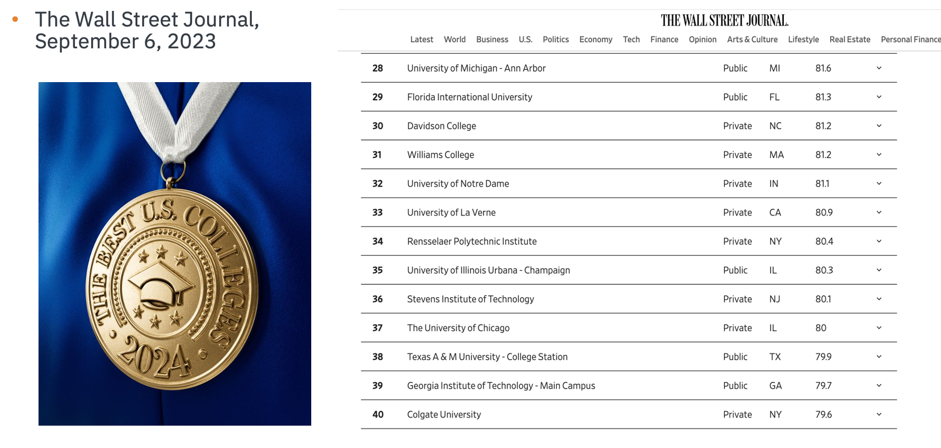
Wall Street Journal Ranking

Slide 11
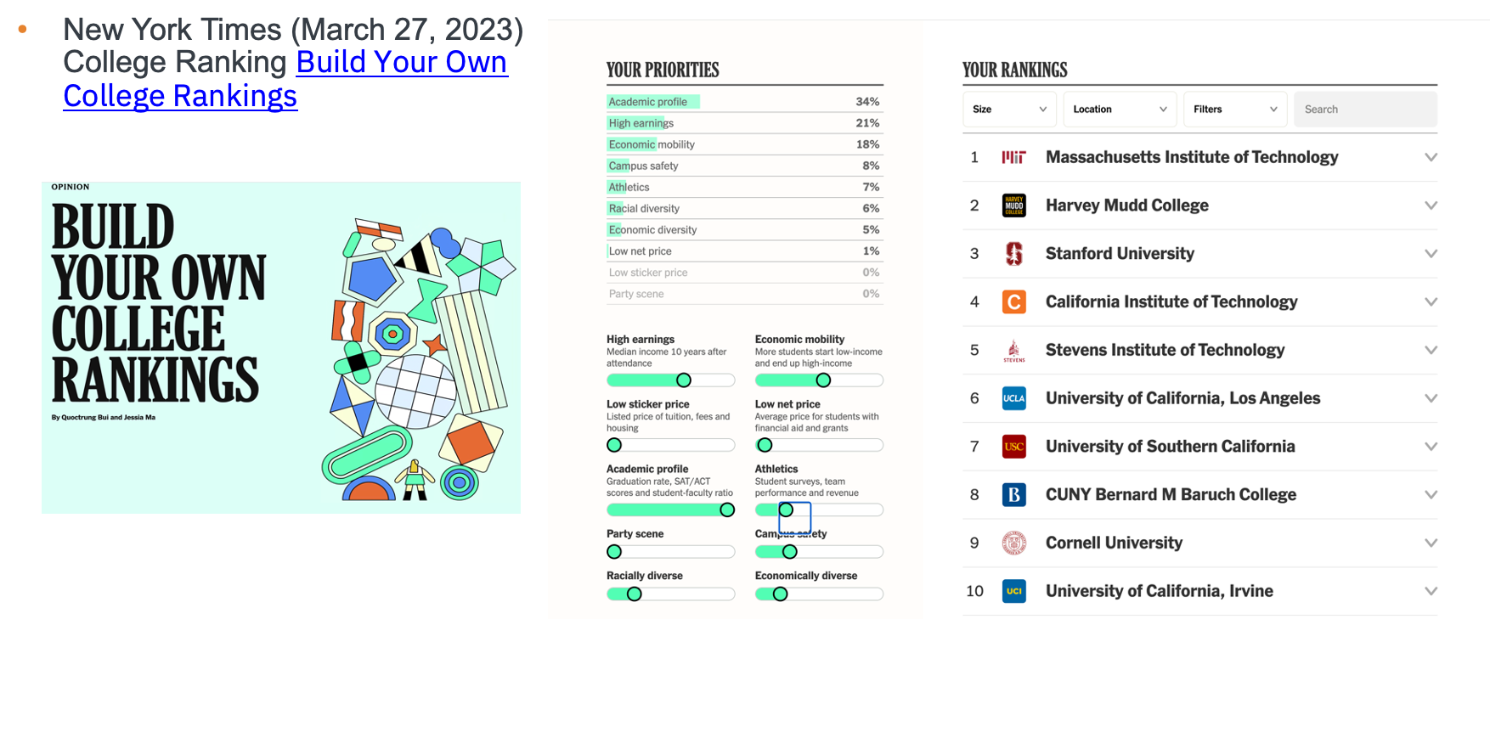
New York Times Ranking

Slide 12
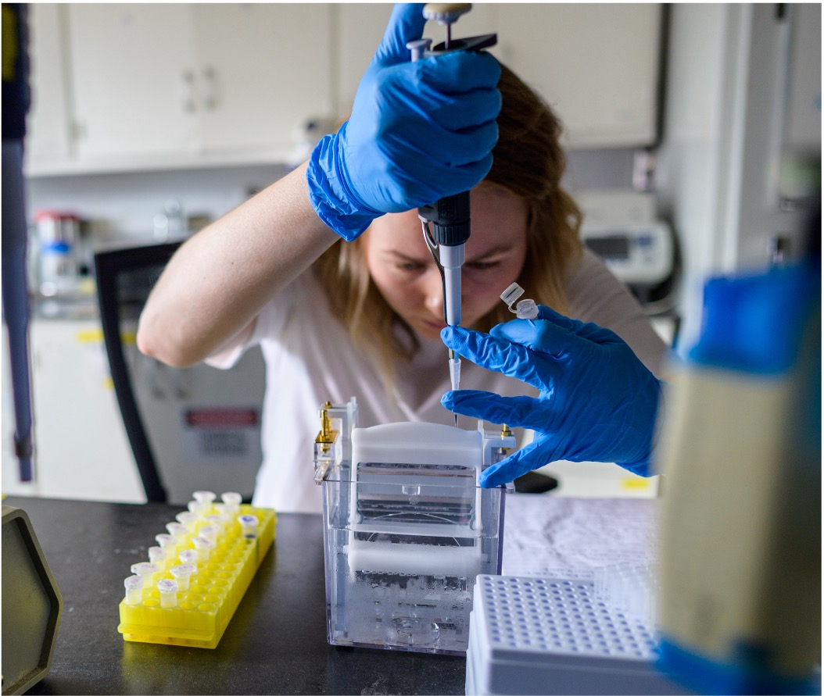
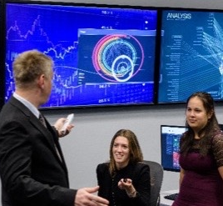
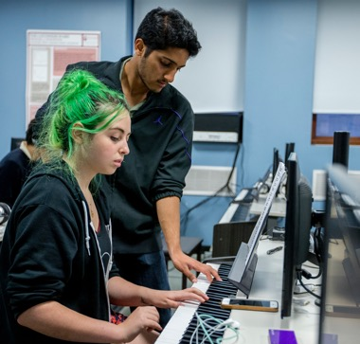
Three Technology-Focused Schools
Charles V. Schaefer, Jr. School
of Engineering and Science
Advancing scientific knowledge to create groundbreaking solutions to 21st century challenges
School of Business
Leading innovation in business management and finance, across industries and around the globe
School of Humanities, Arts and Social Sciences
Uniting humanities, arts, science and technology to inspire and inform change and innovation

Slide 13
School of Engineering and Science
SES Facts and Figures at a Glance
3,056
Undergraduate Students
2,155
Master’s Students
446
Ph.D. Students
5,657
Total Students
240
Full-Time Faculty
872
Courses
$77.3M
Research funding
8
Research Centers
95%
First-Year Retention Rate
89%
Six-Year Graduation Rate

Slide 14
School of Engineering and Science
SES Facts and Figures at a Glance
73%
of UG Students
are SES
69%
of Masters Students
are SES
88%
of Ph.D. Students
are SES
65%
of Stevens faculty are SES
72%
of Total Stevens Students are SES
98%
of Stevens Research Enterprise

Slide 15
10 Departments
Department of Biomedical Engineering
Department of Chemical Engineering and Materials Science
Department of Chemistry and Chemical Biology
Department of Civil, Environmental and Ocean Engineering
Department of Computer Science
Department of Electrical and Computer Engineering
Department of Mathematical Sciences
Department of Mechanical Engineering
Department of Physics
Department of Systems Engineering

Slide 16

National Centers
of Excellence
Center for Advancement of Secure Systems and Information Assurance (CASSIA)
A National Center of Academic Excellence in Cyber Defense
Director: Susanne Wetzel
Systems Engineering Research Center (SERC)
A University-Affiliated Research Center of the U.S. Department of Defense
Director: Dinesh Verma

Slide 17
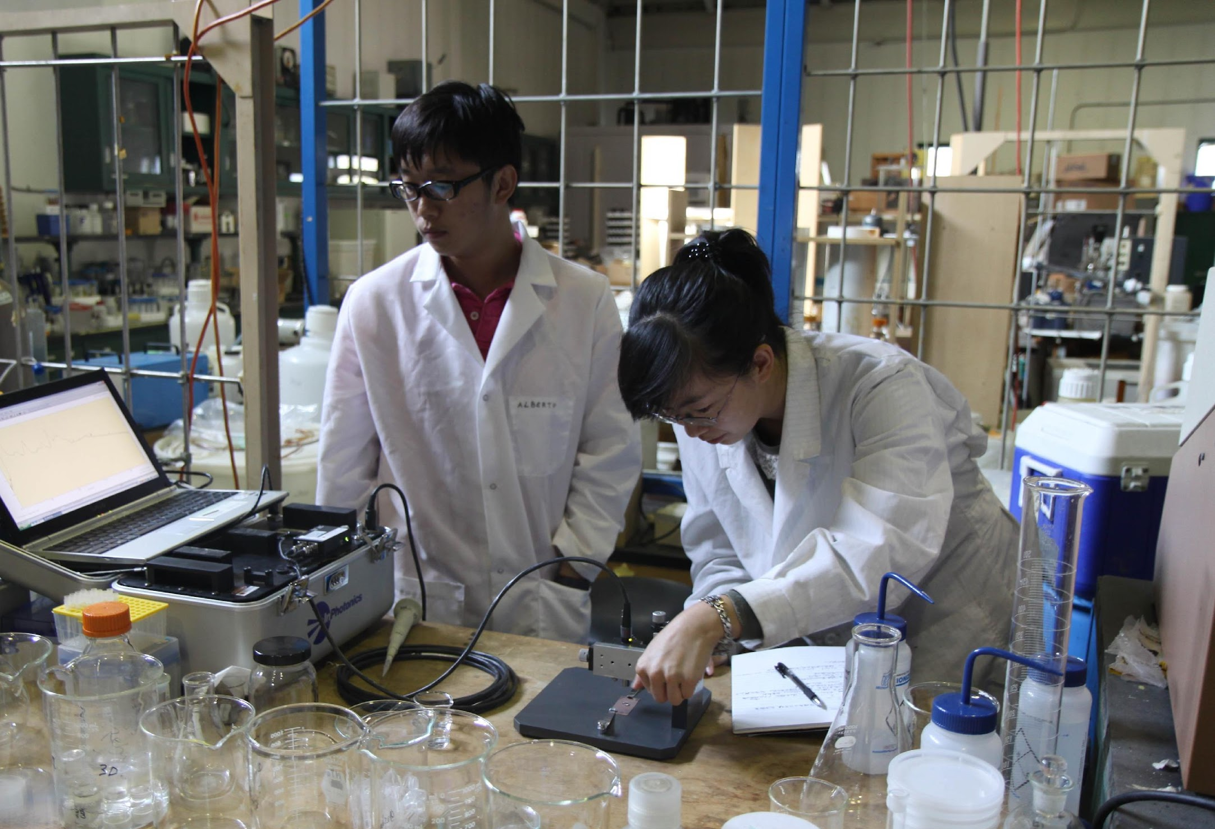
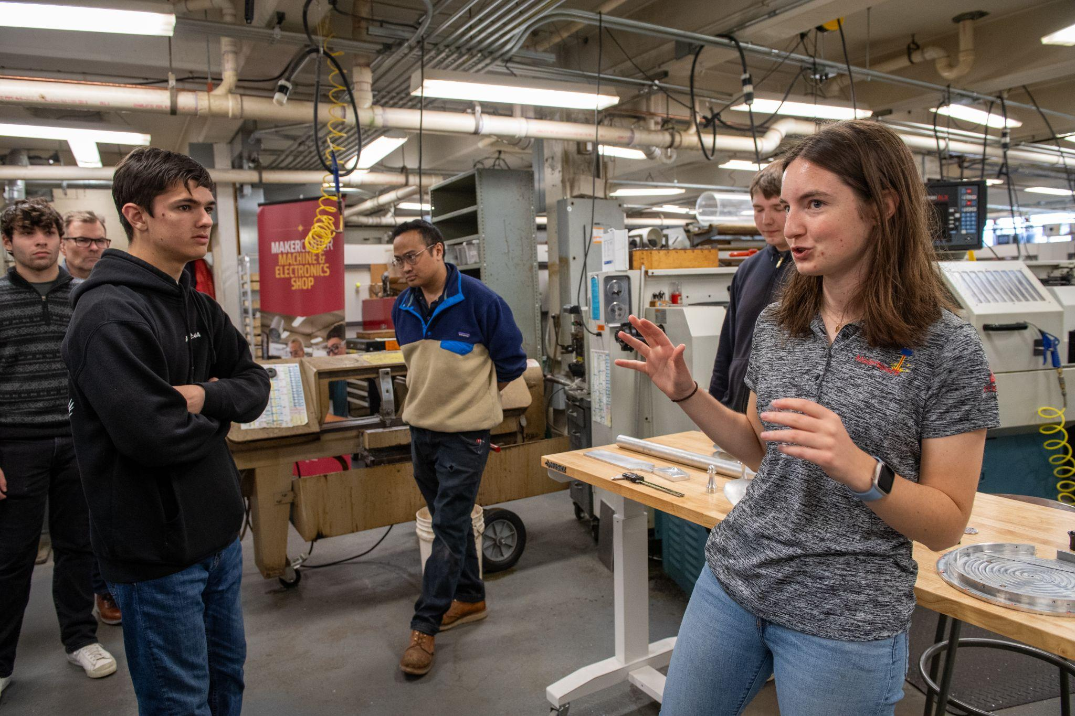
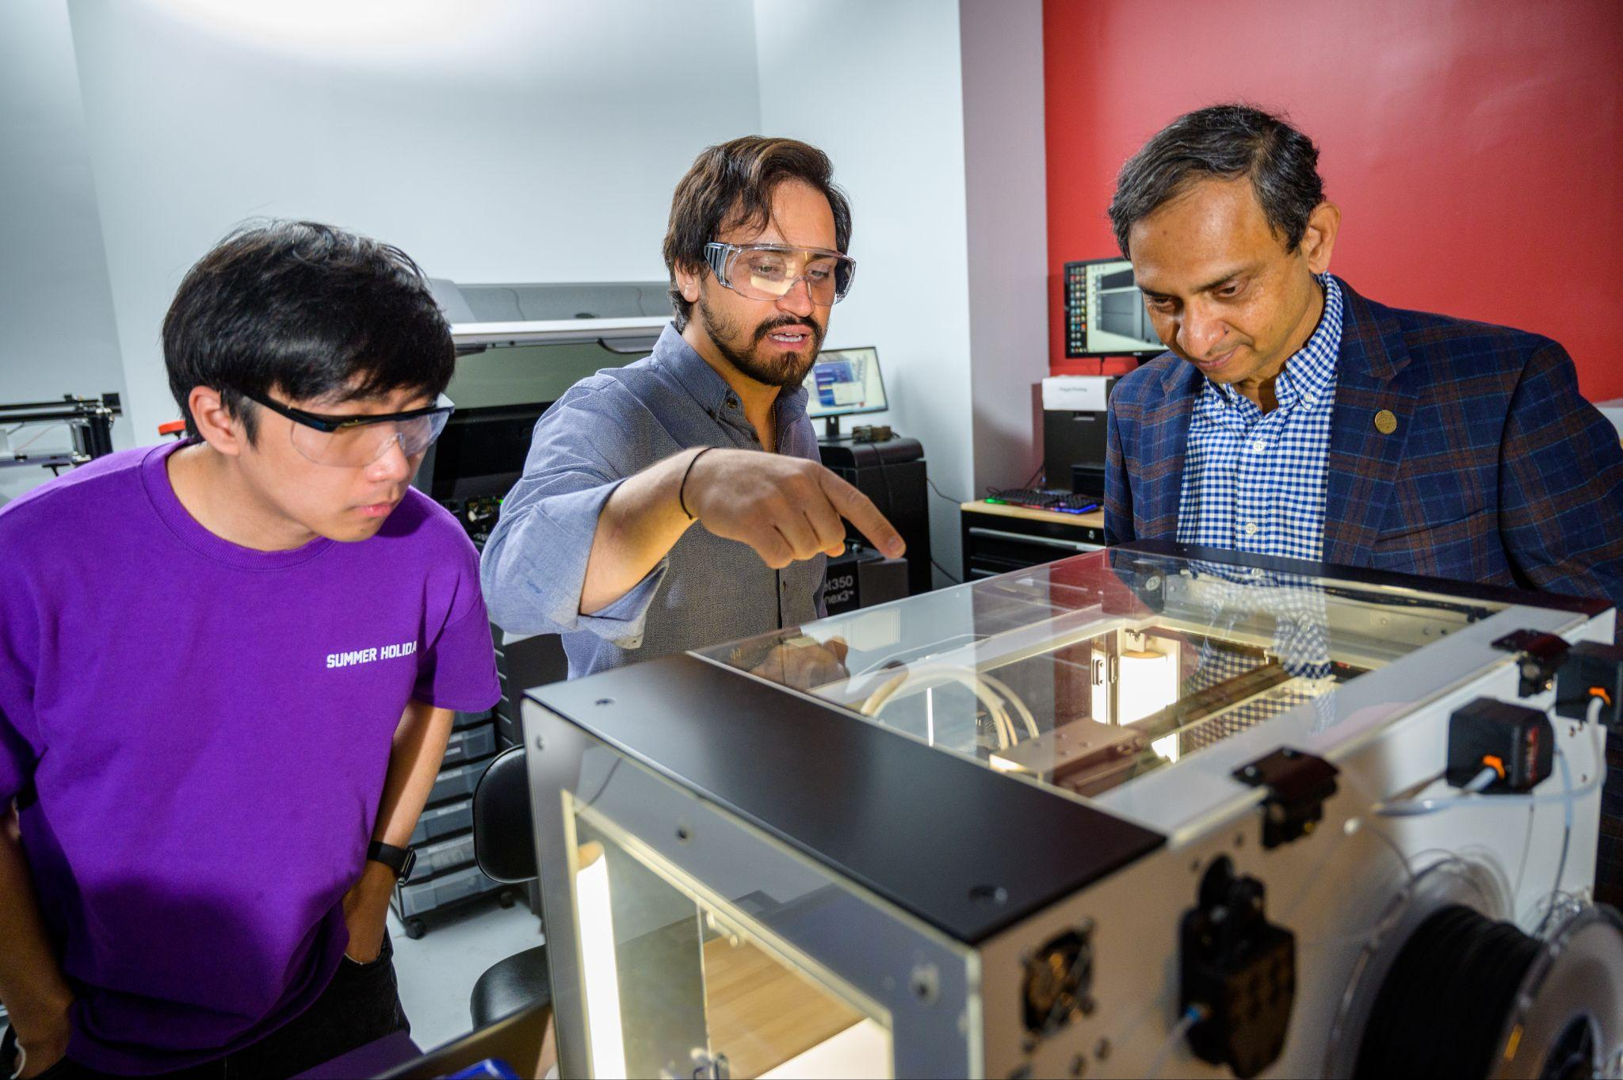
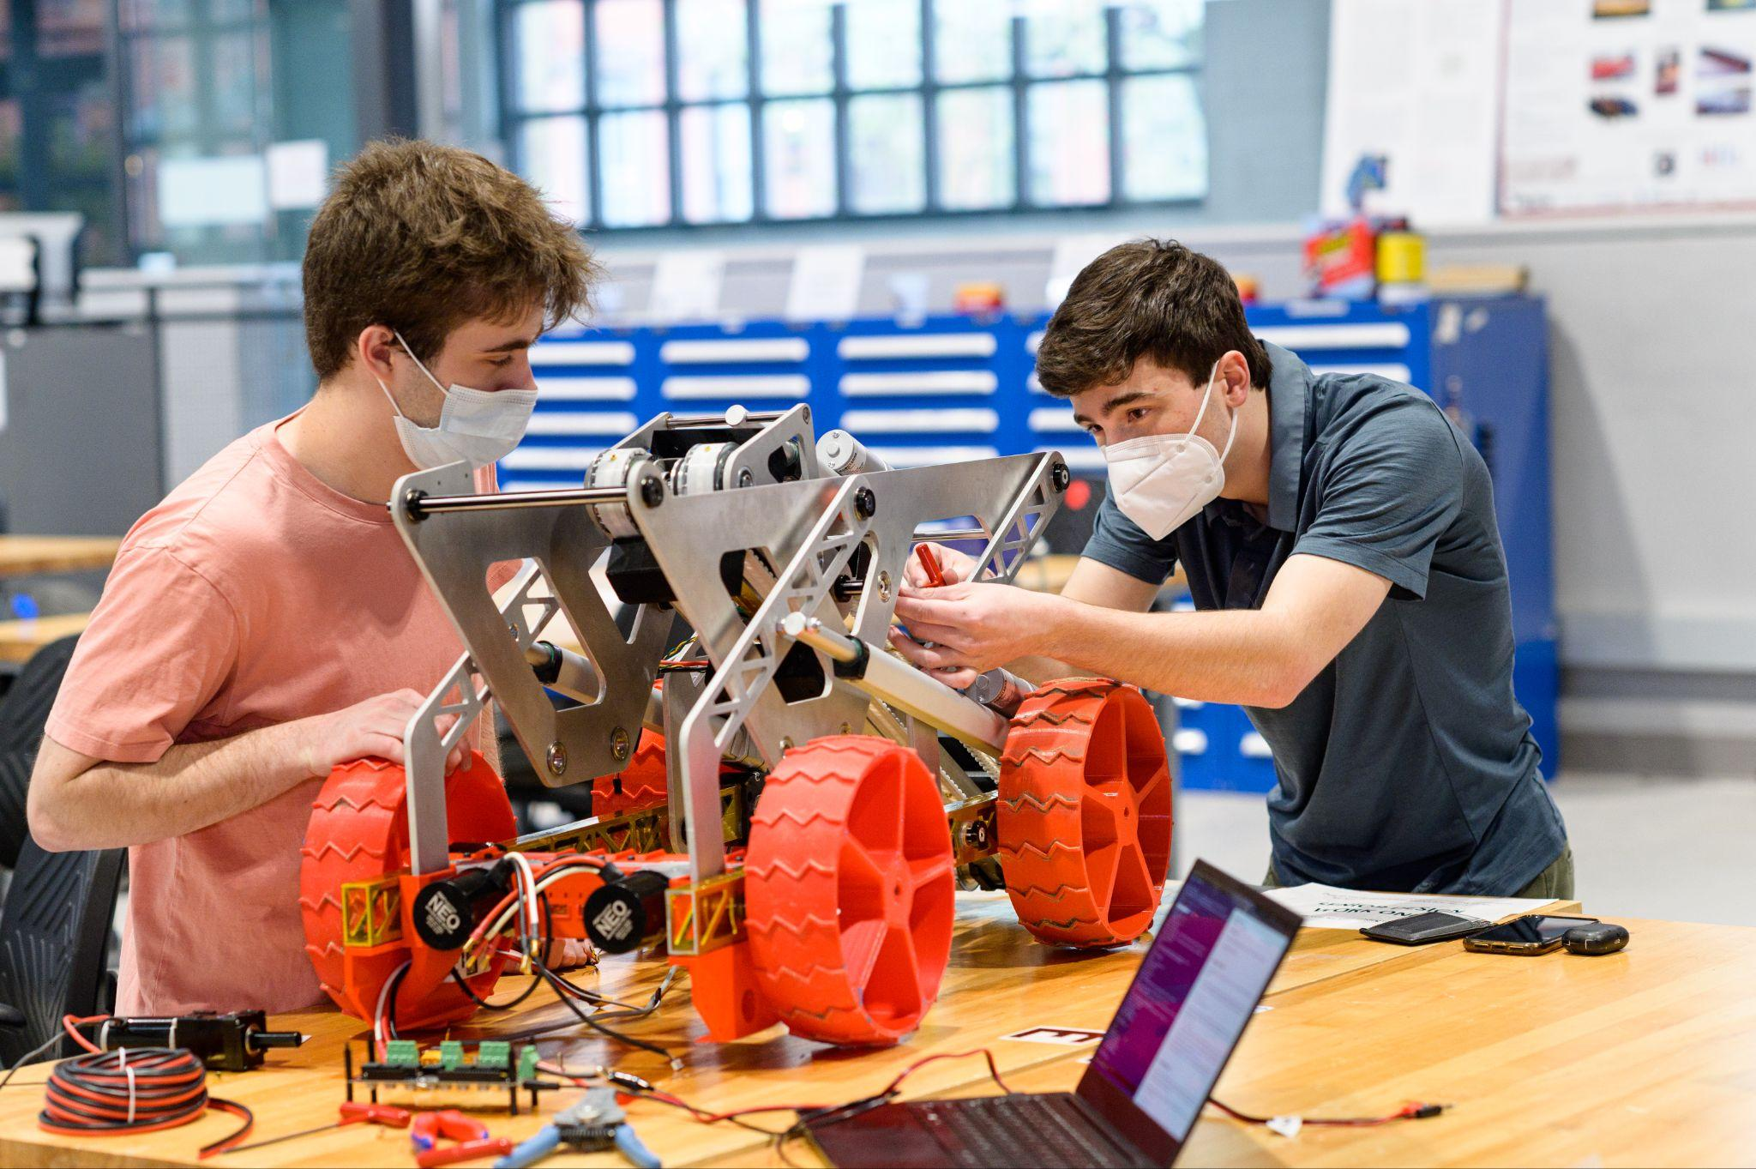
State-of-the-Art Facilities
SES is home to 6 cutting-edge shared facilities
MakerCenter​
High Performance Computing Cluster​
Laboratory for Multiscale Imaging​
MicroDevice Laboratory​
Mass Spectrometry Laboratory​
Prototype Object Fabrication Laboratory​

Slide 18
Corporate Partnerships
SES has established 170+ collaborations with external partners through sponsored research, capstone design projects, faculty consultations, hiring, and philanthropy. Our partners include:
Merck
Colgate-Palmolive
Atlantic Shores Offshore
Wind LLC
L3Harries Technologies
WSP
NASA
Samsung
Verizon
Amazon
Port Authority
Raytheon
Con Edison
Lenovo
Stryker
Kearfott
Gibbs & Cox
H2M Architects & Engineers
ADP
AstraZeneca
BASF
ExxonMobil
Hugo Neu
Go!Foton
PSEG
HDR
Northrop Grumman
Picatinny Arsenal
AT&T
MTF Biologics
Langan Inc.
Thornton Tomasetti
General Dynamics Mission Systems
Sono-Tek

Slide 19
Undergraduate Studies

Slide 20
19 Undergraduate Programs
Engineering
Science
Biomedical Engineering
Chemical Engineering
Civil Engineering
Computer Engineering
Electrical Engineering
Engineering Management
Environmental Engineering
Industrial and Systems Engineering
Mechanical Engineering
Engineering – Naval Engineering
Software Engineering
Artificial Intelligence (Fall 2026)
Biology
Chemistry
Chemical Biology
Computer Science
Cybersecurity
Mathematics
Physics

Slide 21
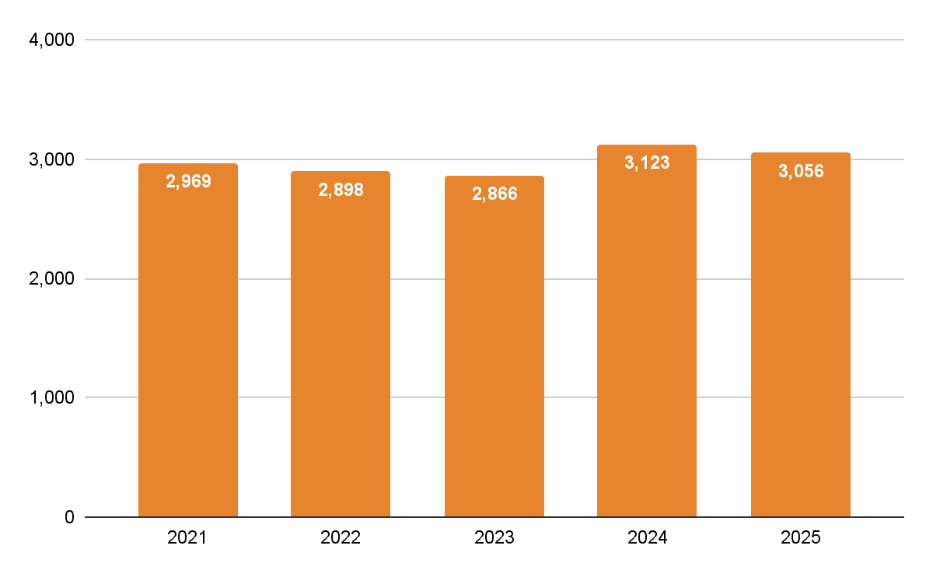
Undergraduate Enrollment

Slide 22
Curriculum Overview
​ | Stevens (ME)​ | Stevens (CE)​ | Stevens (CS)​
Math​ | 10.6%​ | 10.7%​ | 13.2%​
Science​ | 11.3%​ | 9.3%​ | 7.8%​
Humanities​ | 12.7%​ | 12.9%​ | 14.0%​
Writing & Communication​ | 4.2%​ | 4.3%​ | 4.7%​
Innovation & Entrepreneurship​ | 3.5%​ | 3.6%​ | 0.0%​
Major/Disciplinary Courses​ | 51.4%​ | 52.9%​ | 55.8%​
General Electives​ | 6.3%​ | 6.4%​ | 4.7%​

Slide 23
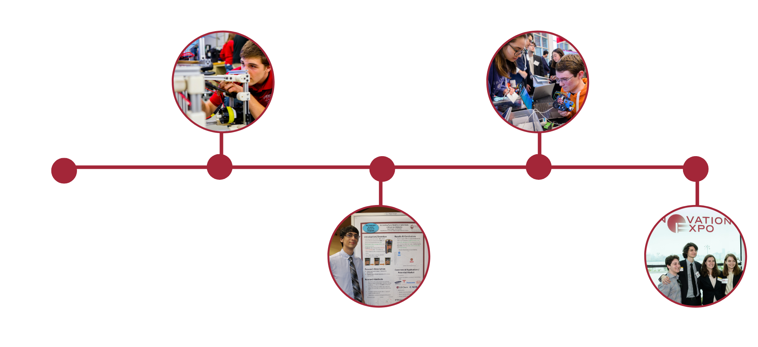
Engineering Design Spine
Series of 12 undergraduate design courses that teaches students to synthesize, analyze, and optimize solutions for open-ended and societally impactful problems.
Year 1
Year 3
  Engineering Design & Systems Thinking
  Automation with Sensors
  Entrepreneurial Thinking
  Design with Materials
  Engineering Design
  Engineering Economics & Project Management
  Statics and Introduction to Engineering Mechanics
  Design of Dynamical Systems
  Capstone Design
  Innovation: Proposition Value
  Innovation: Venture Planning
& Pitch
Year 2
Year 4

Slide 24
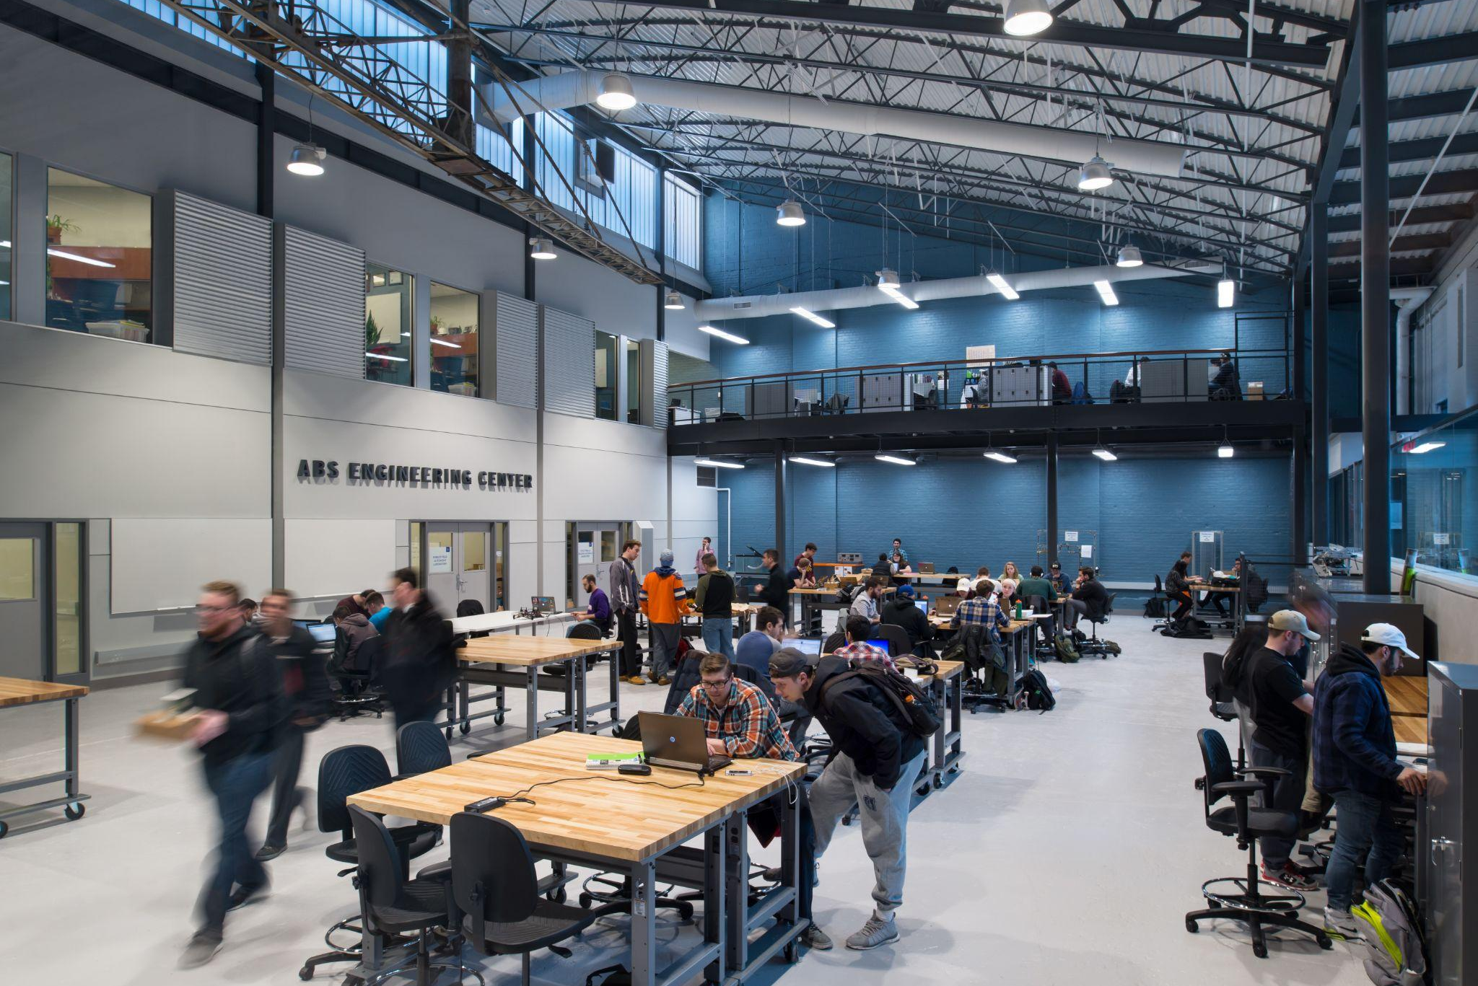
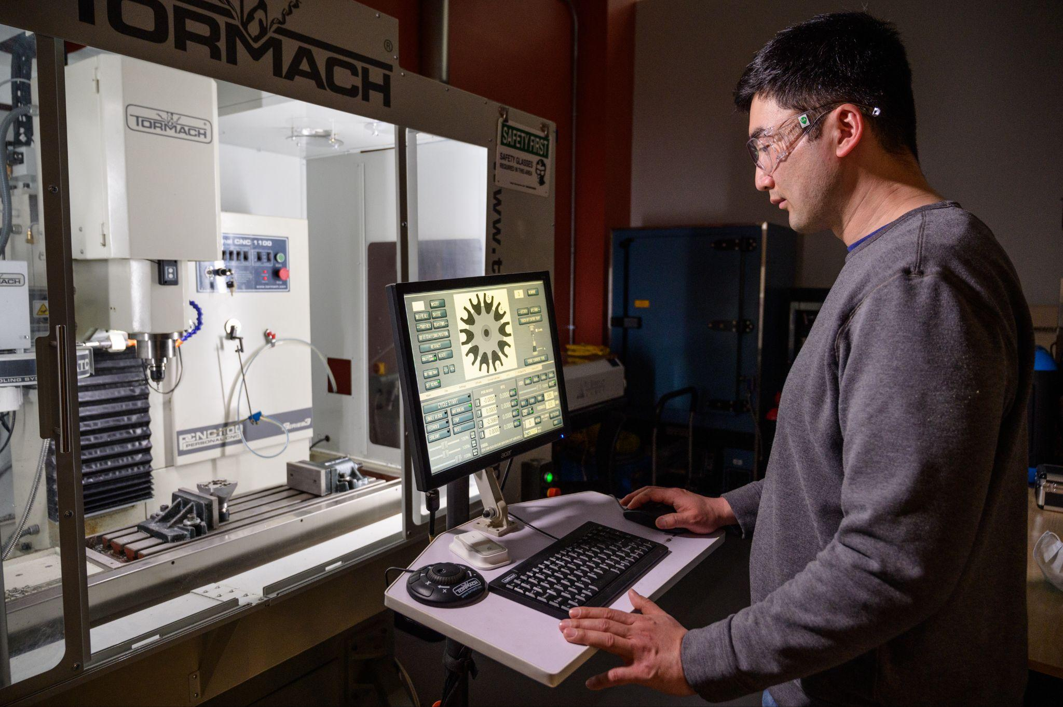

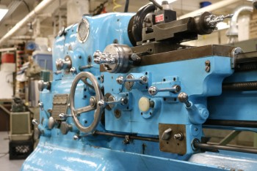


MakerCenter
ABS MakerSpace
ProOF Laboratory
Quantum Space
Machine Shop
Electronics Shop
Welding Shop

Slide 25
iSTEM@Stevens
An exclusive entrepreneurship training program that enables students to design and build technologies and businesses that will shape the future.
Unique, four-year program​
Combination of classes and independent studies woven into the curriculum
​Companies worth over $36M
95.8%
Retention Rate
20
Portfolio Companies
Produced
3
Average Incorporations Per Year

Slide 26
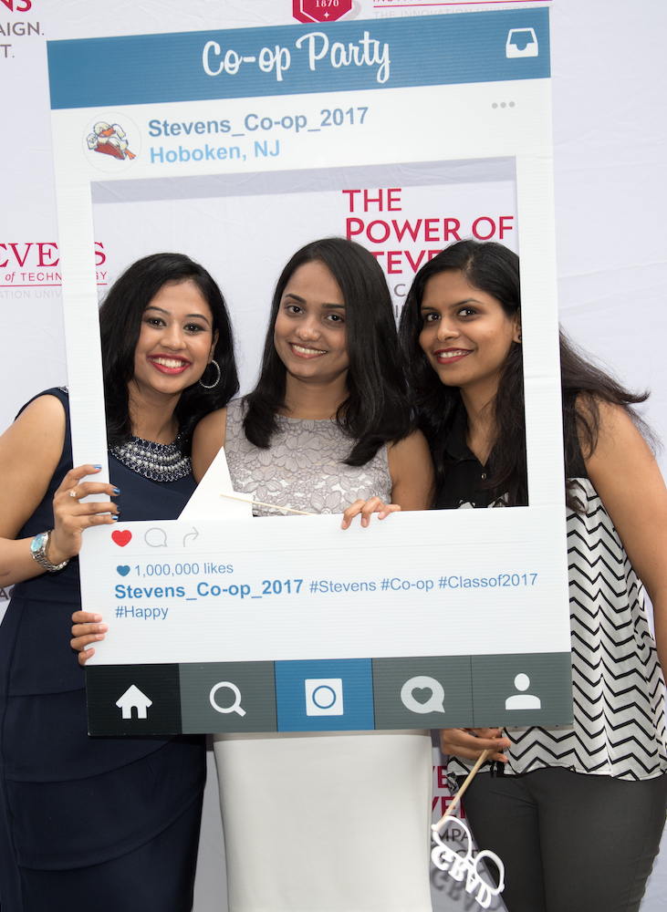
Co-op Programs
Combining classroom education with practical real-world work experience
Our 4-year competitive program allows students to:
Supplement academic study with full-time paid professional work
Gain valuable work experience in a job related to their degree before graduation
Earn a full-time hourly salary during each work rotation
Establish and broaden a network of professional contacts in a career field and industry

Slide 27
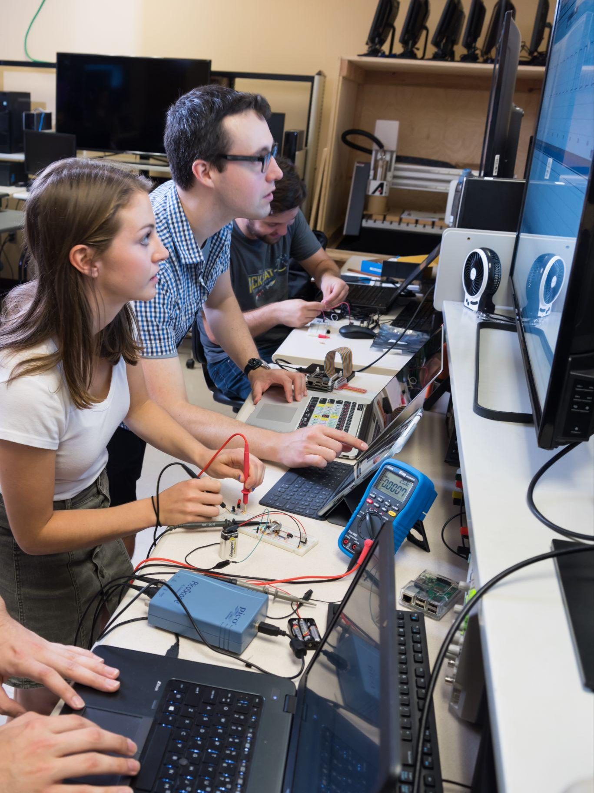
Summer Research
Hands-On Research Experience
Each department provides undergraduate students with research opportunities
The Stevens Institute for Artificial Intelligence AI Research Summer (AIRS) Fellowship Program
NSF-funded Research Experiences for Undergraduates (REU) Site Program

Slide 28
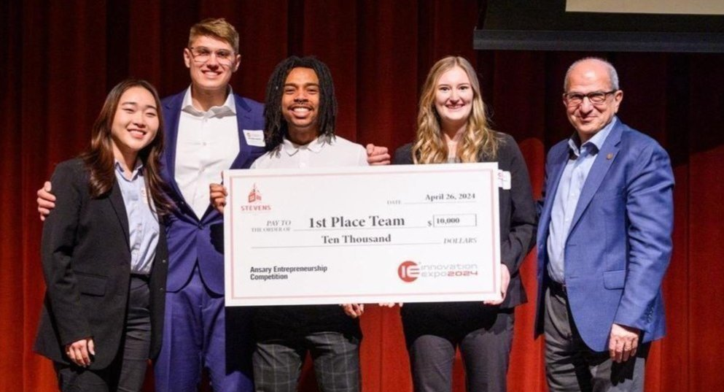
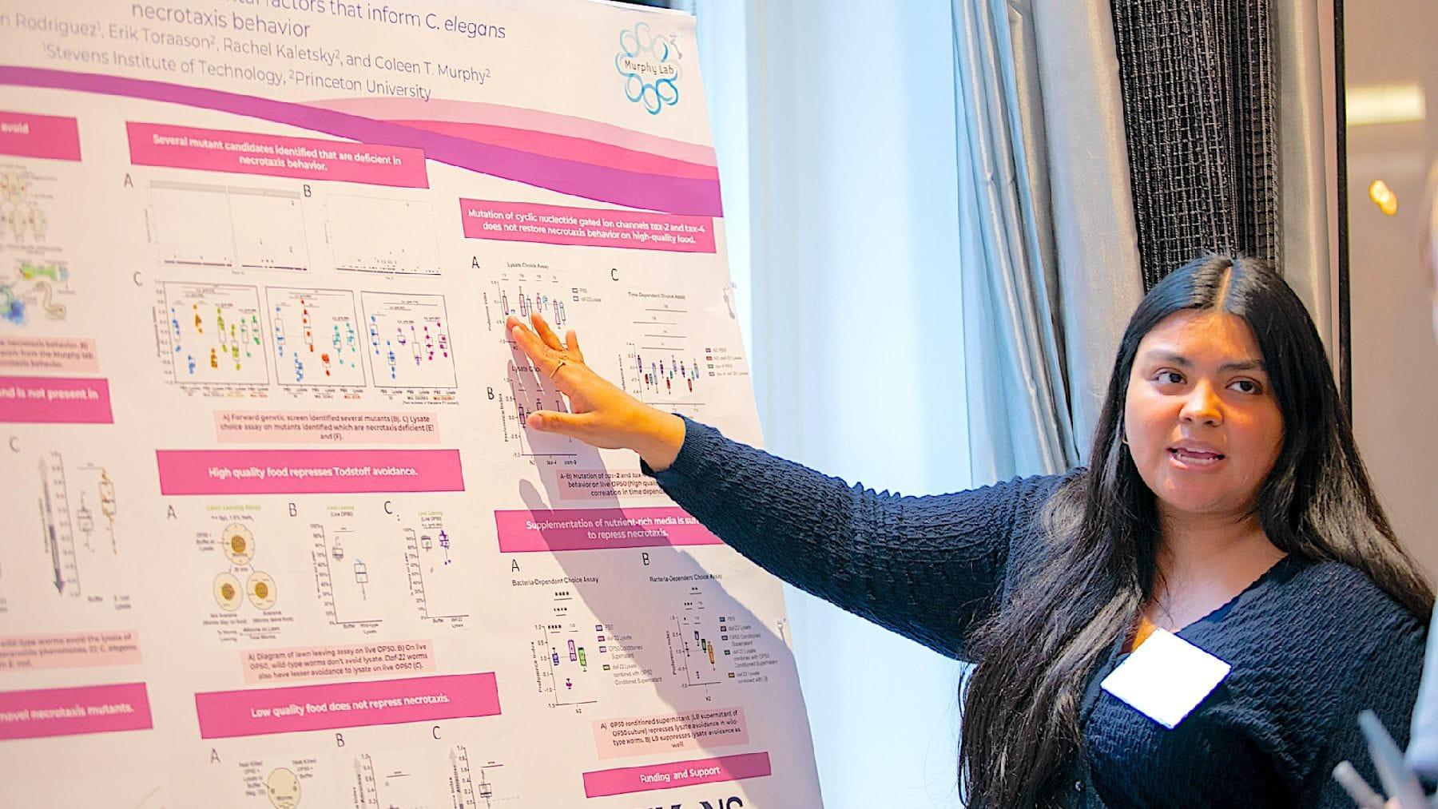
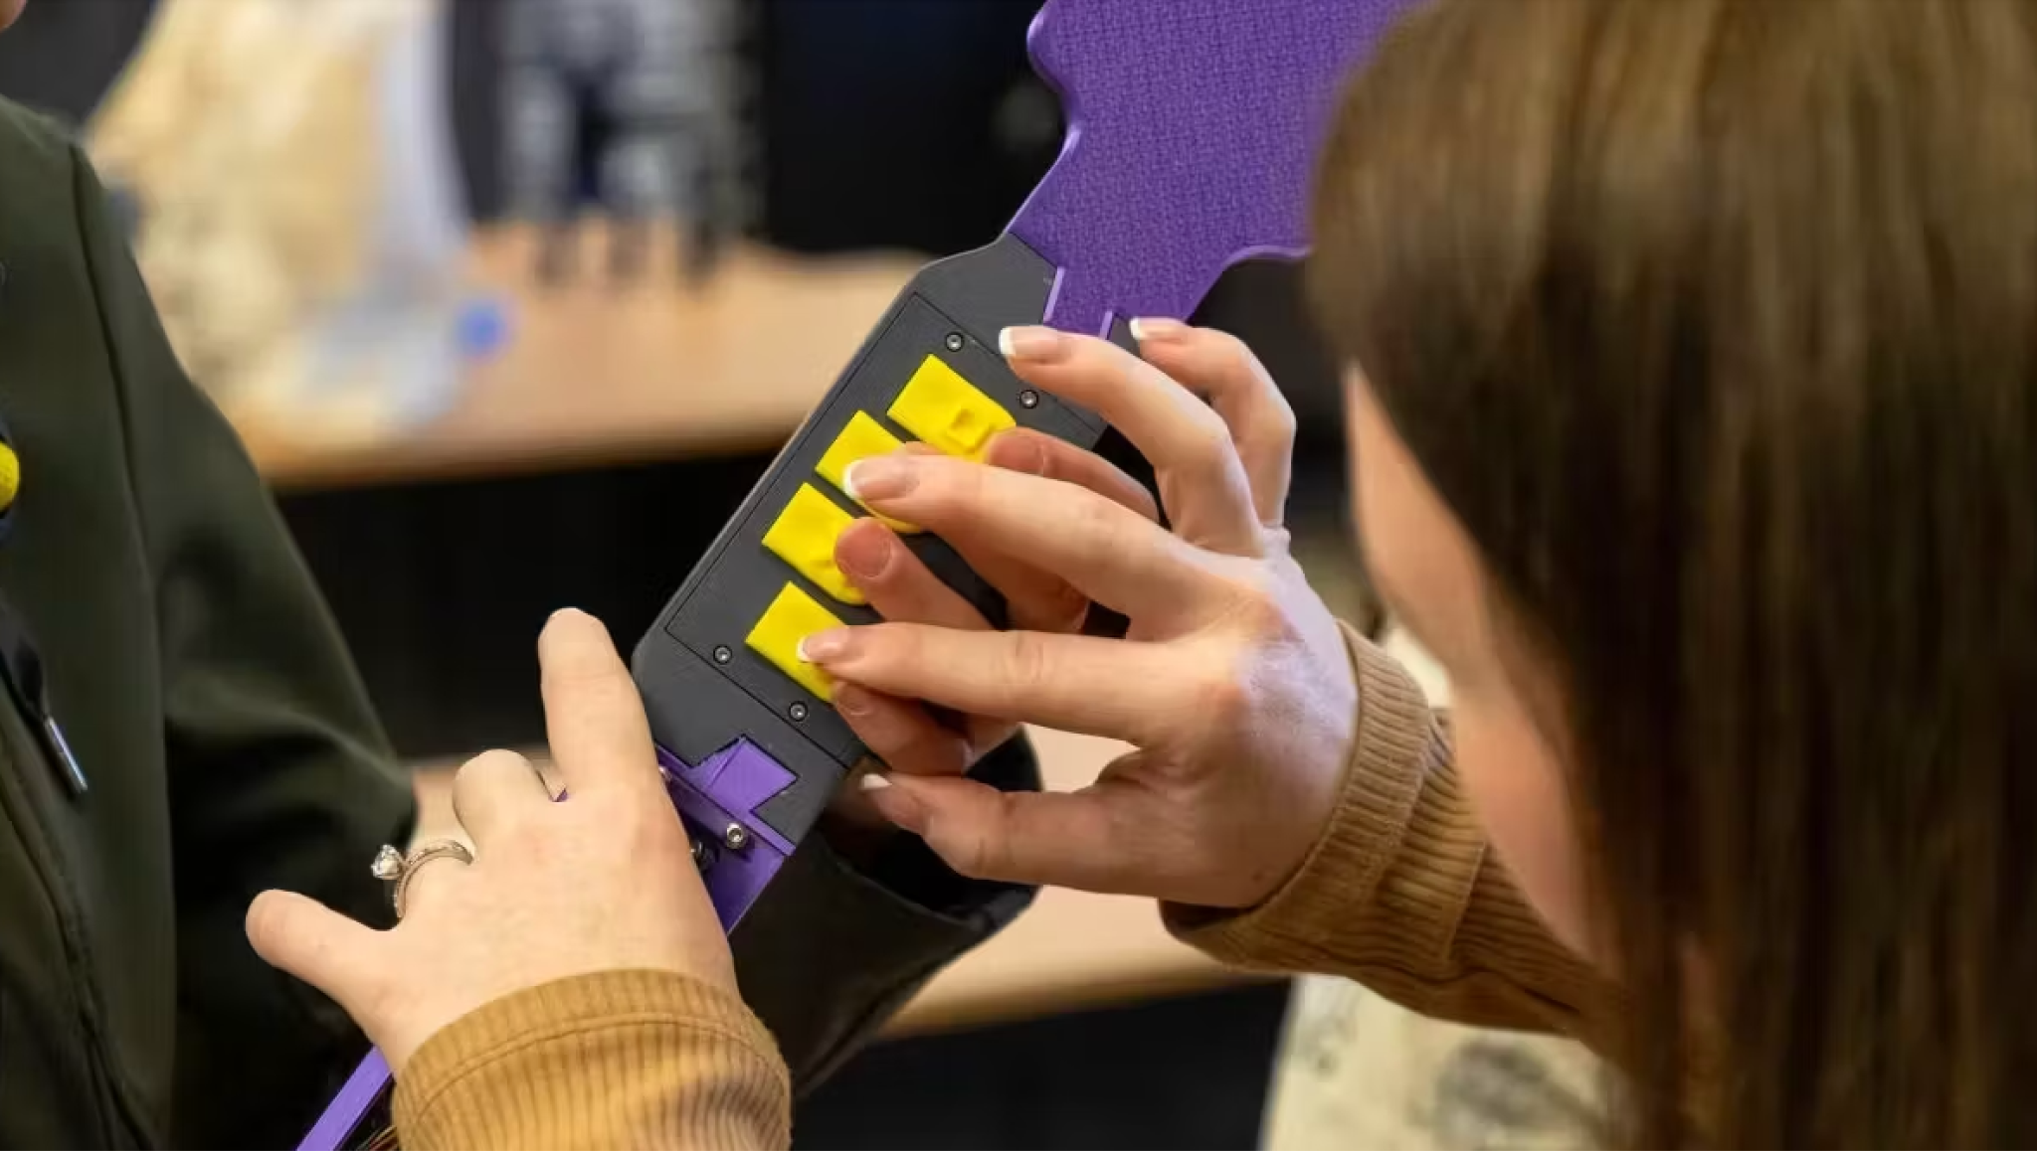
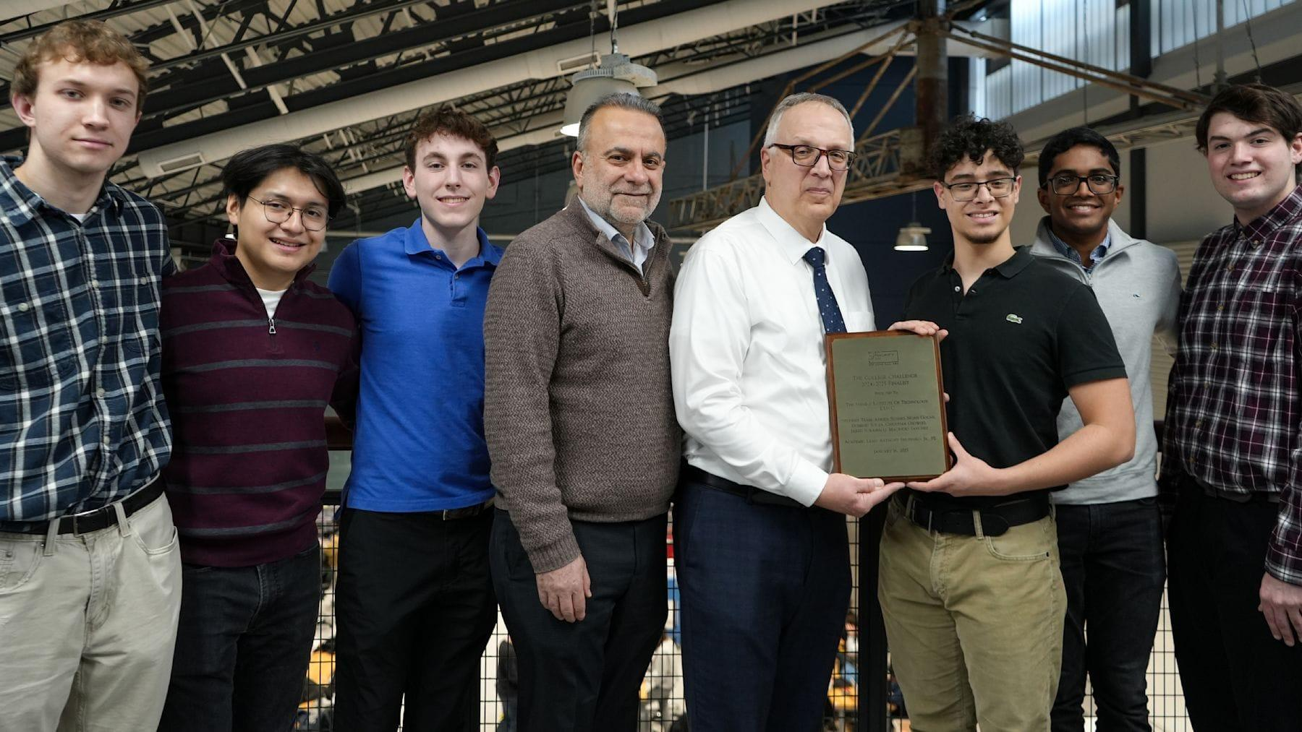

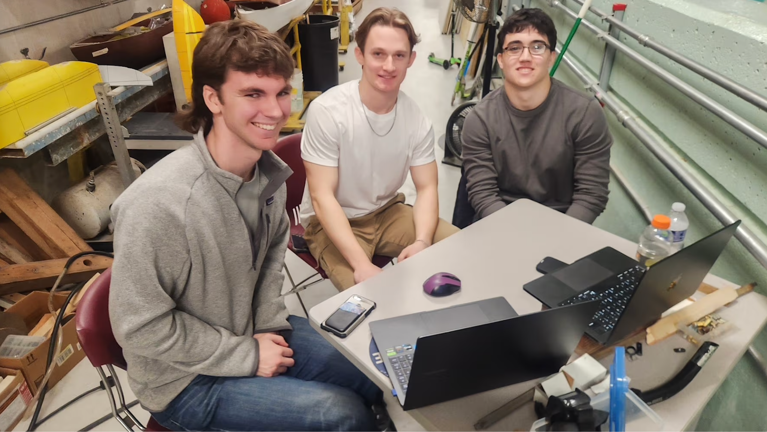
Student Achievements
$15K Venture Prize: DEBUT Challenge
Two SES Students Chosen for
Simons’ SURFiN Fellowship
1st Place: RESNA Student Design Challenge
Finalists: Port Authority
NY/NJ College Challenge
Prestigious Goldwater Scholarship Awarded to Stevens Undergrad
$10K 1st Prize: Homeland Security
Design Challenge

Slide 29
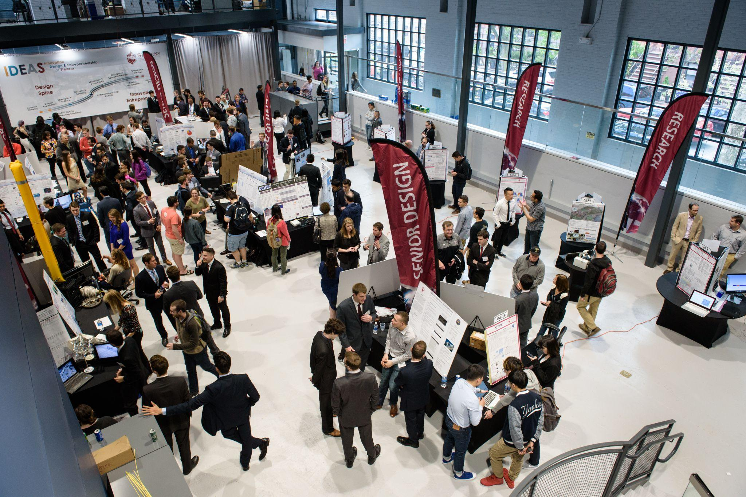
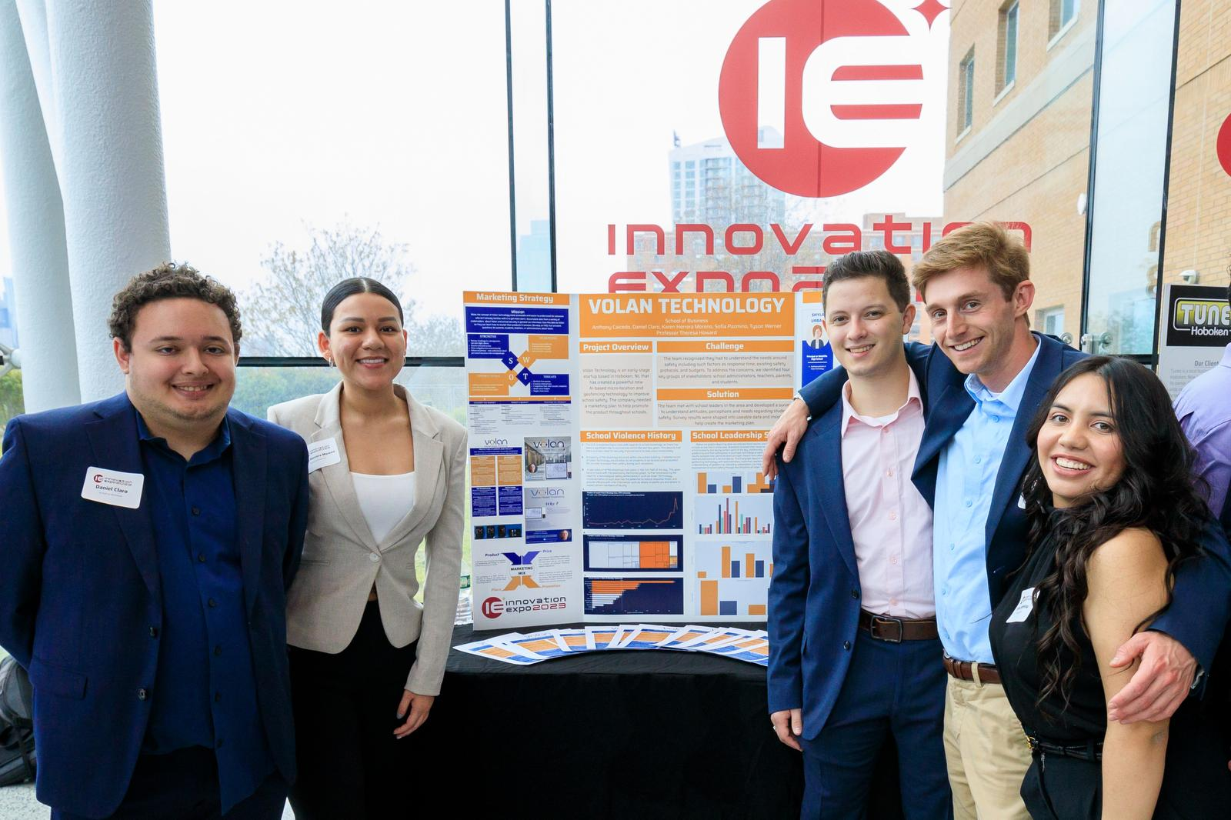
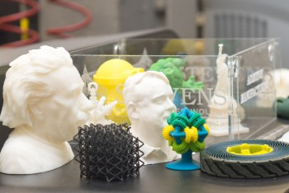
Innovation Expo
An annual showcase for student design, innovation and entrepreneurship.

Slide 30
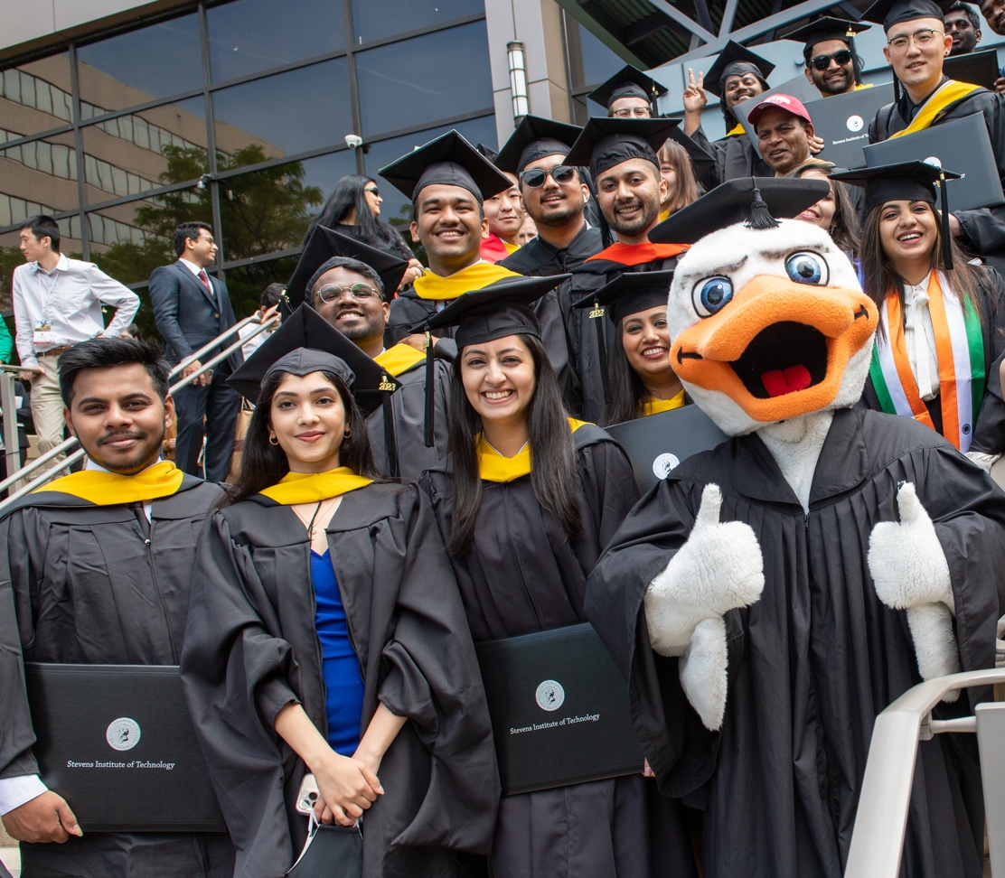
Undergraduate Career Outcomes
Stellar student outcomes are a Stevens standard
$85,367
Average starting salary of SES graduates
96%
of students secured their career outcomes
within six months of graduation
Data from the Career Outcomes Report for the Class of 2024

Slide 31
Graduate Studies

Slide 32
USNWR Rankings of Graduate Programs
#19
Online Graduate
Information Technology Programs
U.S. News & World Report, 2025-26
#74
Best Graduate
Engineering Schools
U.S. News & World Report, 2025-26
#36
Online Graduate
Engineering Programs
U.S. News & World Report, 2025-26
#1 in NJ
Online Graduate
Engineering Programs
U.S. News & World Report, 2025-26
#6
Online Graduate Industrial Engineering Programs
U.S. News & World Report, 2025-26
#78
Electrical Engineering Graduate Programs
U.S. News & World Report, 2025-26
#71
Computer Engineering Graduate Programs
U.S. News & World Report, 2025-26
#44
Systems Engineering Graduate Programs
U.S. News & World Report, 2025-26
#80
Best Graduate Computer Science Schools
U.S. News & World Report, 2025-26
#78
Biomedical Engineering Graduate Programs
U.S. News & World Report, 2025-26
#77
Materials Science Graduate Programs
U.S. News & World Report, 2025-26
#81
Environmental Engineering Graduate Programs
U.S. News & World Report, 2025-26

Slide 33
31 Master’s Programs
Actuarial Mathematics & Quantitative Risk
Applied Artificial Intelligence
Applied Mathematics
Biomedical Engineering
Chemical Biology
Chemical Engineering
Chemistry
Civil Engineering
Computer Engineering
Computer Science
Construction Engineering & Management
Cybersecurity
Data Science
Electrical Engineering
Engineering Management
Environmental Engineering
Interdisciplinary
Machine Learning
Materials Science & Engineering
Mathematics
Mechanical Engineering
Ocean Engineering
Pharmaceutical Manufacturing
Physics
Quantum Engineering
Robotics
Software Engineering
Space Systems Engineering
Sustainability Management
Systems Analytics
Systems Engineering

Slide 34
19 Ph.D. Programs
Biomedical Engineering
Chemical Biology
Chemical Engineering
Chemistry
Civil Engineering
Computer Engineering
Computer Science
Data Science
Electrical Engineering
Engineering Management
Environmental Engineering
Interdisciplinary
Materials Science & Engineering
Mathematics
Mechanical Engineering
Ocean Engineering
Physics
Robotics
Systems Engineering

Slide 35
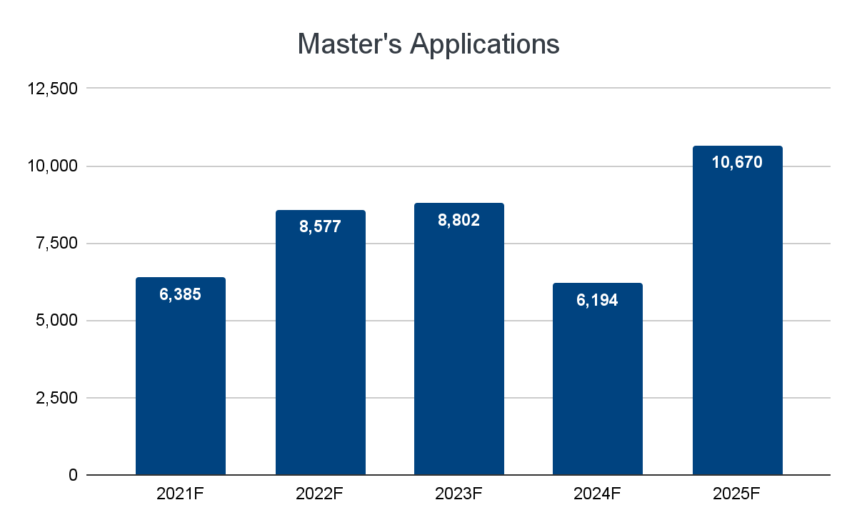
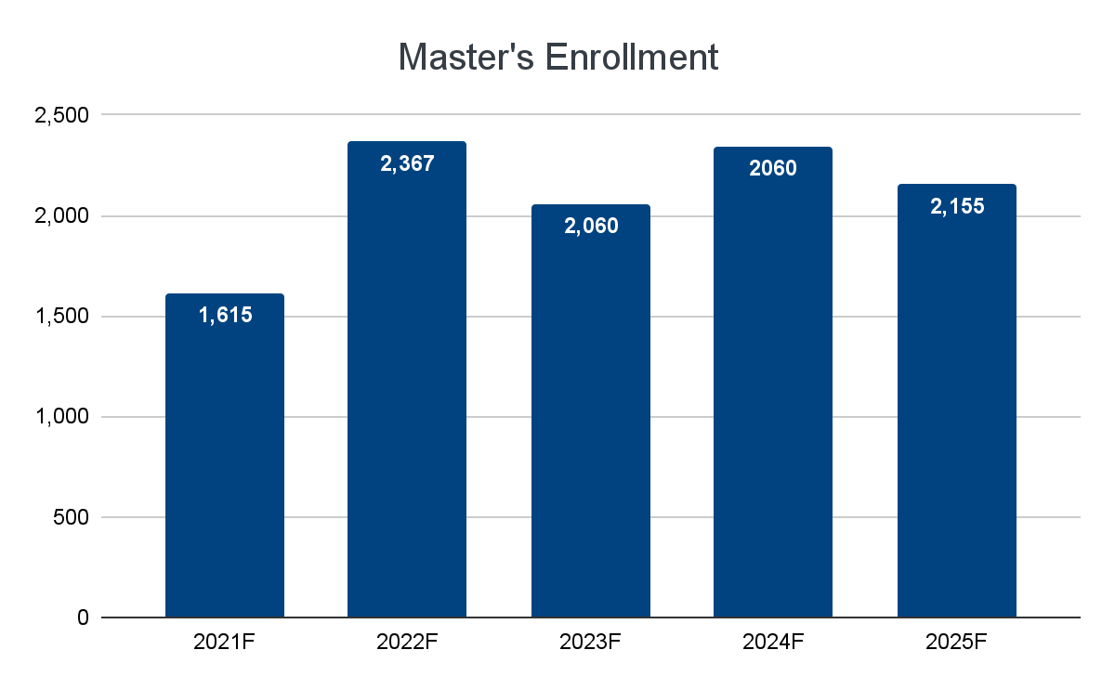
Master’s Applications & Enrollment
Notes:
Need to update numbers:
2023F
Master's Application: 8814 (up from 8582 last year)
Master's Enrollment: 2102 (down from 2367 last year)

Slide 36
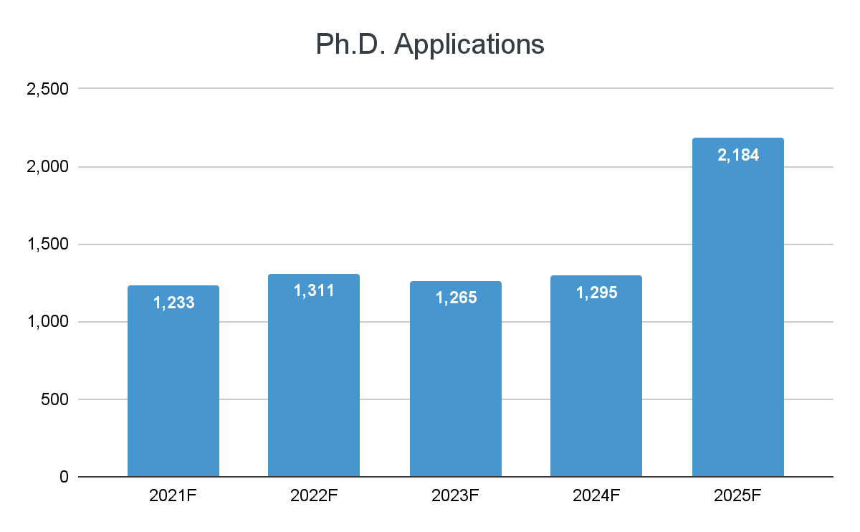
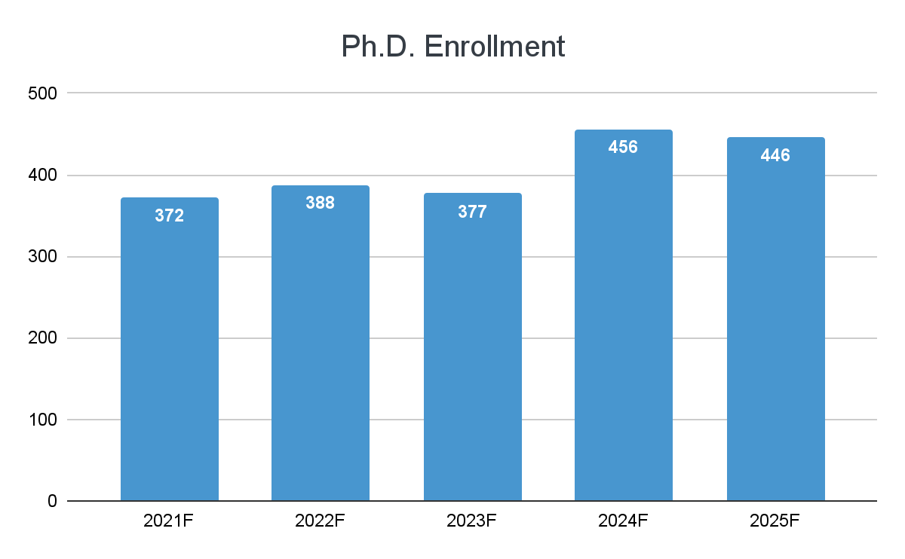
Ph.D. Applications and Enrollment
Notes:
Update:
2023F
PhD Applications: 1256 (down from 1309 last year)
PhD Enrollment: 368 to date, (down from 388 last year)

Slide 37
Joint Programs with 17 Universities
Inter-University Engineering Doctoral Consortium, New York/New Jersey
Stevens, NYU, NYUIT, Rutgers, CCNY, Columbia, Cornell, Princeton
Ecole Centrale de Nantes, France - Dual-Degree Ph.D.
Xidan University, China - M.Eng.
Xi’an Jiaotong University, China - M.Eng., M.S.
Hackensack Meridian School of Medicine, New Jersey, USA - M.S.
Chongqing University of Posts and Telecommunications(CQUPT), China - M.Eng.
Seton Hall University, New Jersey, USA - M.Eng., M.S.
Shanghai University, China - M.Eng.
St. Peter’s University, New Jersey, USA - M.S.
Montclair University, New Jersey, USA - M.S.
University of Sharjah, United Arab Emirates - Ph.D.

Slide 38
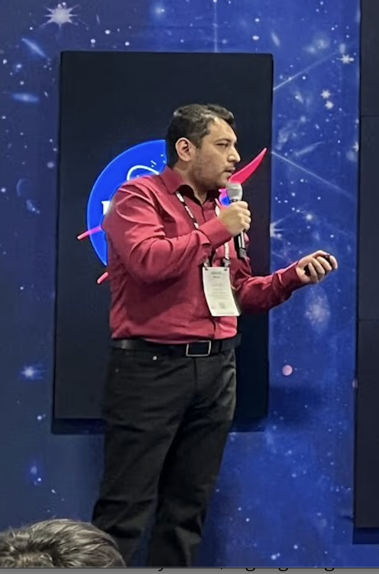
Student Achievements
Department of Biomedical Engineering student was awarded the Merit Switzer Research Fellowship for Doctoral Dissertation Research, receiving $44K
Department of Systems Engineering Ph.D. student named 2025 American Institute of Aeronautics and Astronautics ASCENDANTS
Department of Chemistry and Chemical Biology Ph.D. student won 2nd Place in the Johnson & Johnson Engineering Showcase Poster and Elevator Pitch Competition
Department of Civil, Environmental and Ocean Engineering Ph.D. student was the grand prize winner of the 2024 AGU Michael H. Freilich Student Visualization Competition
2024 AGU Student Visualization Competition

Slide 39
Research

Slide 40



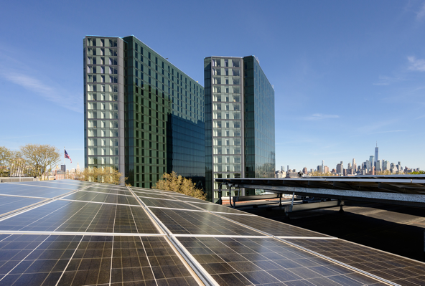
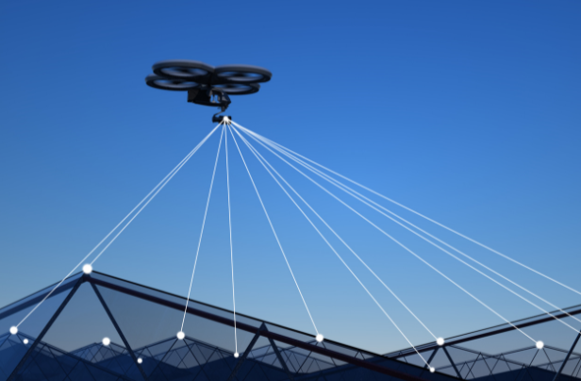
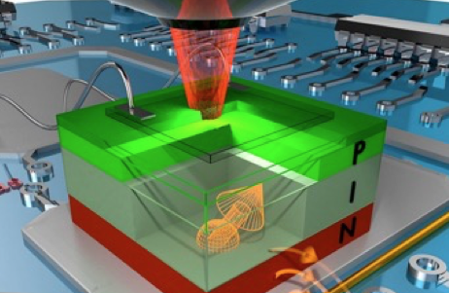


Research Highlights
Stevens research tackles some of the most urgent challenges facing our world today
Artificial Intelligence
Neuromechanics
Cancer Research & Drug Discovery
Energy Innovation
Cyber-Physical Systems
Quantum Technologies
Robotics
Urban & Coastal
Resiliency

Slide 41
8 Research Centers
Center for Environmental Systems​
Semcer Center for Healthcare Innovation​
Center for Innovative Computing and Networked Systems
Center for Quantum Science and Engineering​
Davidson Laboratory​
Stevens Center for Sustainability
Stevens Institute for Artificial Intelligence​
Systems Engineering Research Center

Slide 42

Research Funding Awards

Slide 43

Research Expenditures

Slide 44
2025 Young Investigator Awardees
Tegan Brennan (CS) - NSF CAREER Award
Rod Kim (ECE) - NSF CAREER Award
Ying Wang (SE) - ARO Early Career Award
Tao Ye (CEOE) - NSF CAREER Award

Slide 45

YIA Awards at Stevens Since FY10
* As of 11/2/25

Slide 46
Research Centers

Slide 47

Center for Environmental
Systems
Environmental technology ​
Contaminant fate and transport​
Remedial processes​
Environmental geotechnology​
Environmental monitoring,
analysis, and modeling​
Water conservation​

Slide 48

Center for Innovative Computing
and Networked Systems
Mobile and quantum computing
High-performance computing
Circuits and digital systems
Power and energy systems
Robotics and smart systems
Signal processing and wireless communications
Cybersecurity, cyber-physical systems, and IoT
Open radio access networks
5G/6G and wireless networks
Trustworthy AI and applications

Slide 49

Semcer Center for
Healthcare Innovation
Multifunctional multiscale biomaterials and biofabrication
Molecular, cellular and tissue technologies​
Biomechanics and rehabilitation engineering
Biomedical sensing and imaging​
Drug discovery, development and delivery (4D)

Slide 50

Center for Quantum Science
and Engineering
Quantum computing, control​
Quantum big data analytics​
Quantum materials​
Quantum sensing, imaging​
Quantum communications, cryptography​
Quantum education, industrial relations​

Slide 51

Davidson Laboratory
Climate change and coastal resilience​
Flooding and storm surge prediction​
Experimental and computational marine hydrodynamics
Marine systems: ships, wave energy converters, and submersibles​

Slide 52

Stevens Center for
Sustainability
The Stevens Center for Sustainability aims to provide a collaborative, cross-disciplinary platform for researchers to solve critical problems faced by underserved communities.

Slide 53

Stevens Institute for
Artificial Intelligence
Interdisciplinary, tech-driven collaboration ​
100+ faculty, from every school ​
Advance AI and machine learning ​
Improve disciplines such as healthcare, business operations, industry, and education

Slide 54
Systems Engineering
Research Center
Enterprises and Systems of Systems
Trusted Systems
Systems Engineering and Systems Management Transformation
Human Capital Development

Slide 55


THANK YOU
Stevens Institute of Technology
1 Castle Point Terrace, Hoboken, NJ 07030

